Slide 1


Slide 2
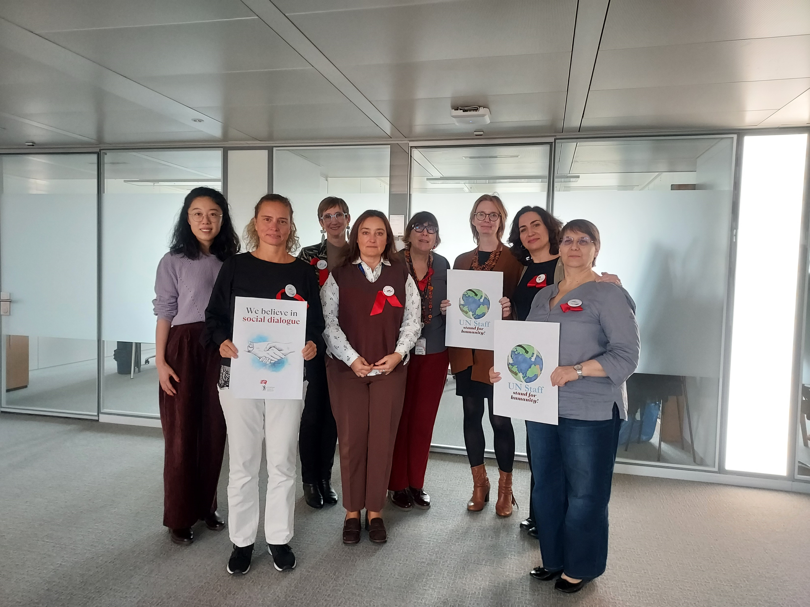
ILO Staff want to be heard!

Slide 3
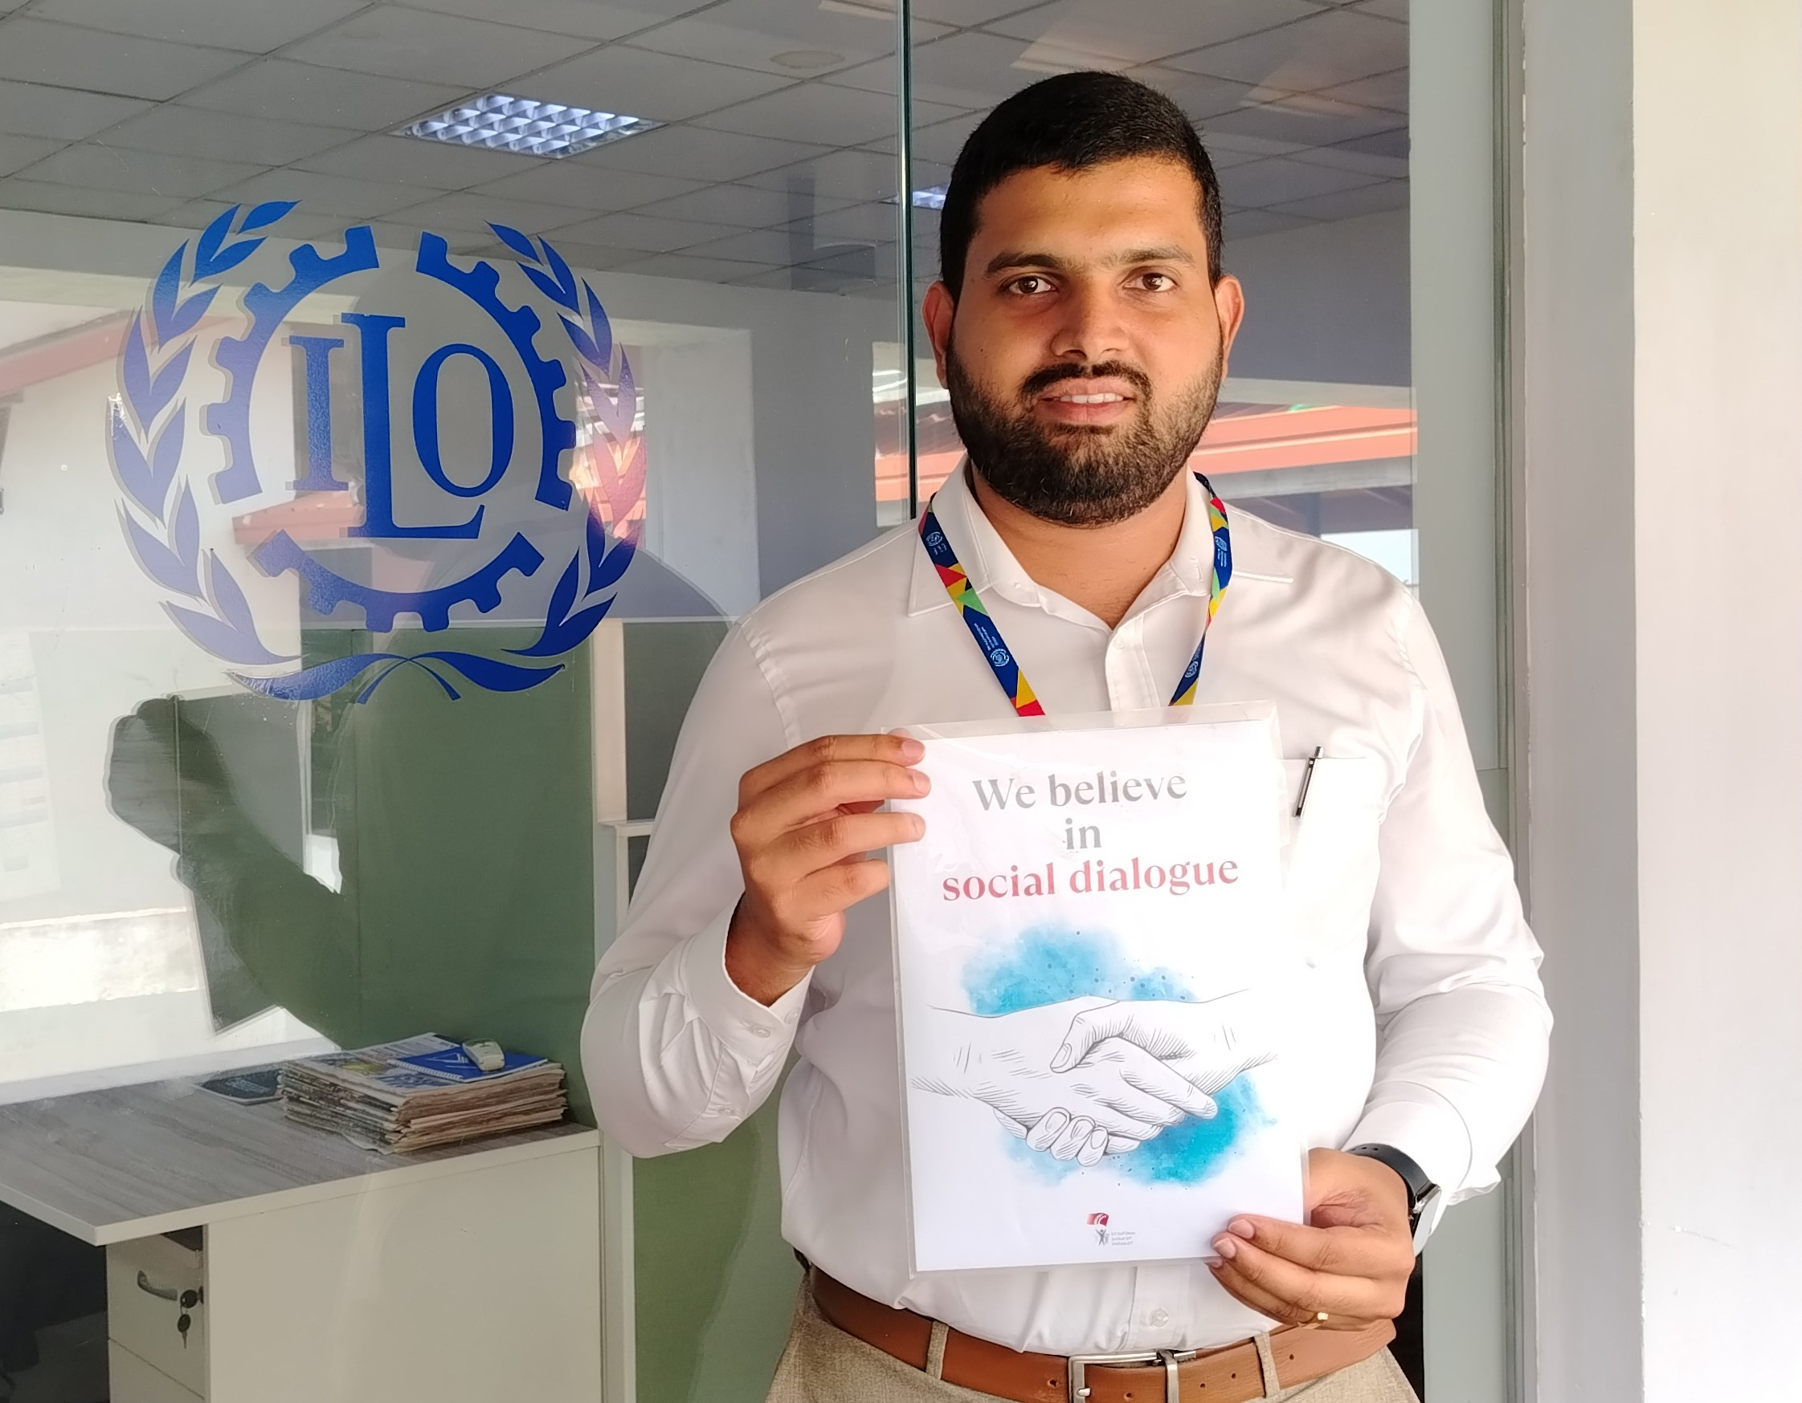
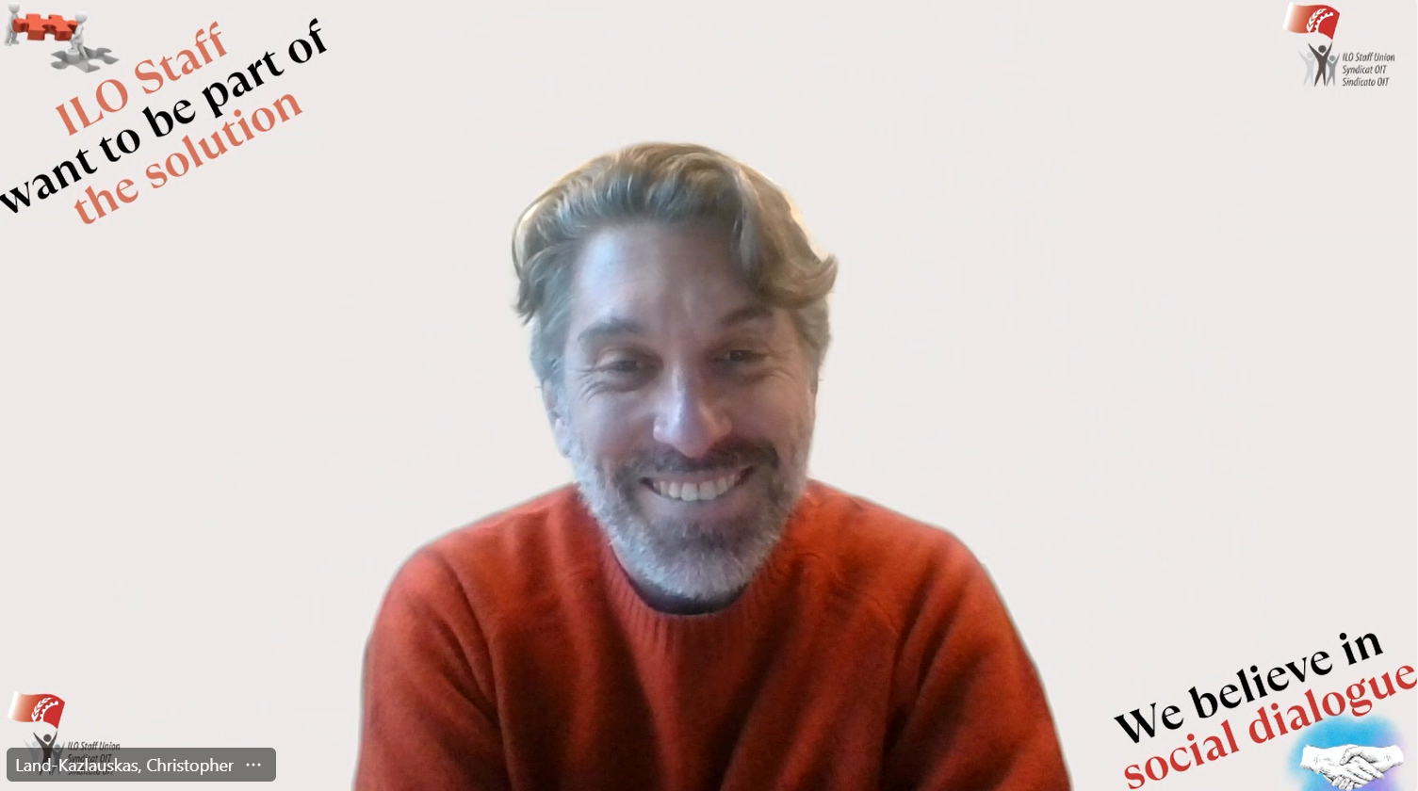
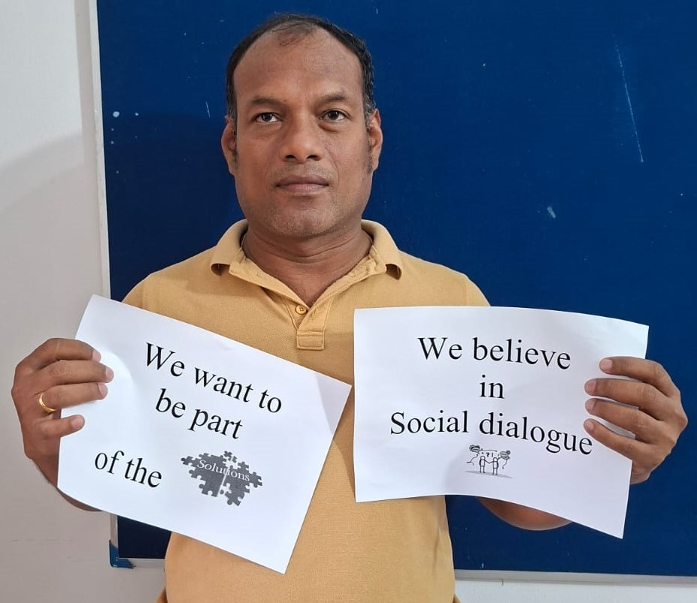


Slide 4
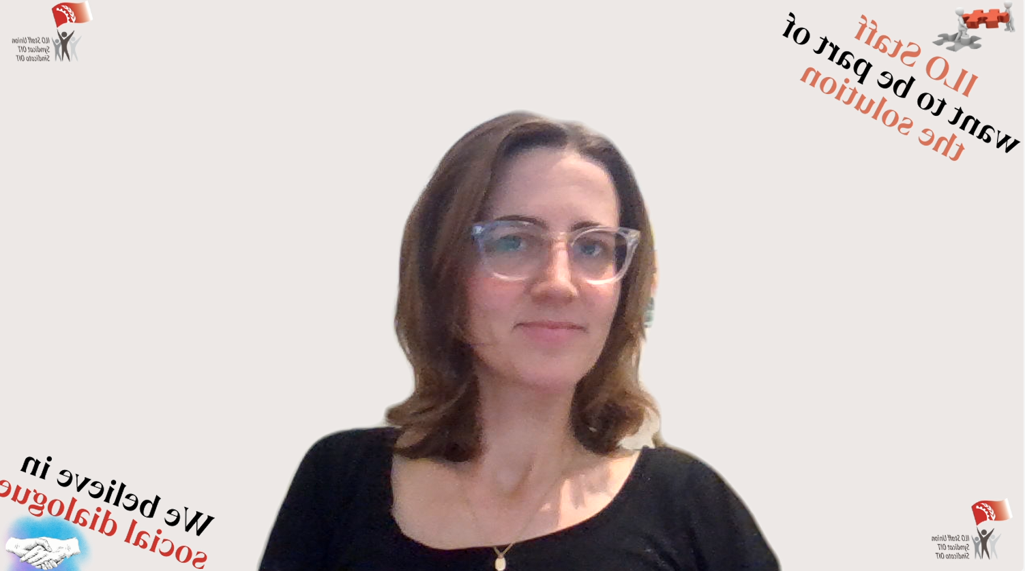

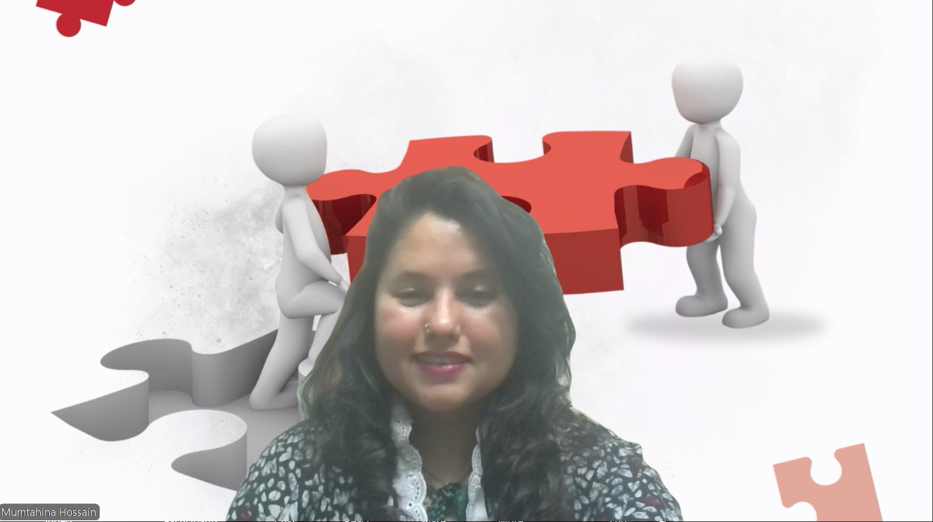
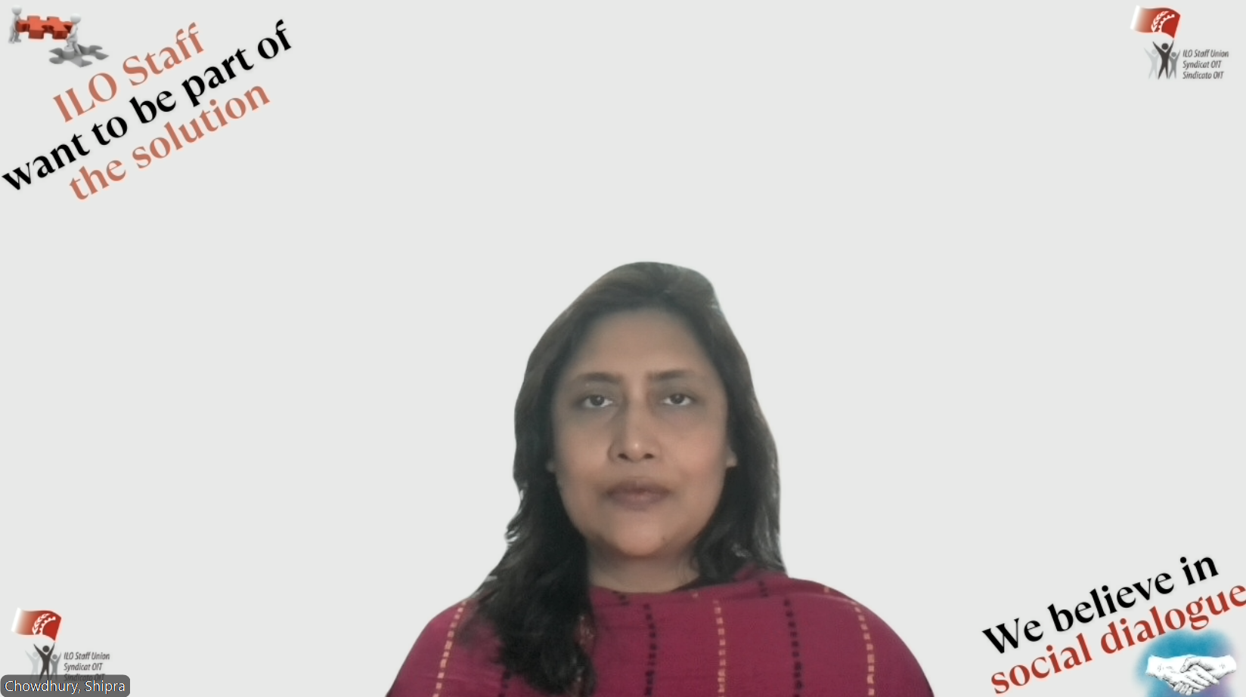

Slide 5


Slide 6





Don't Doha us without hearing us....

Slide 7
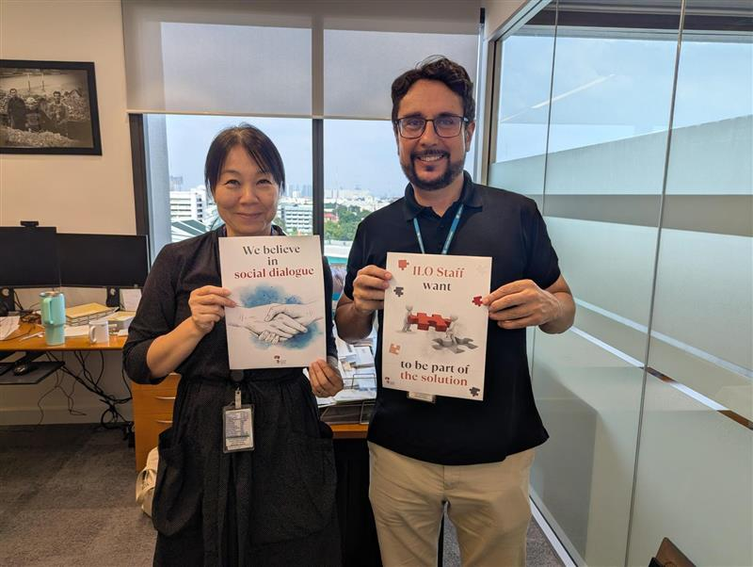

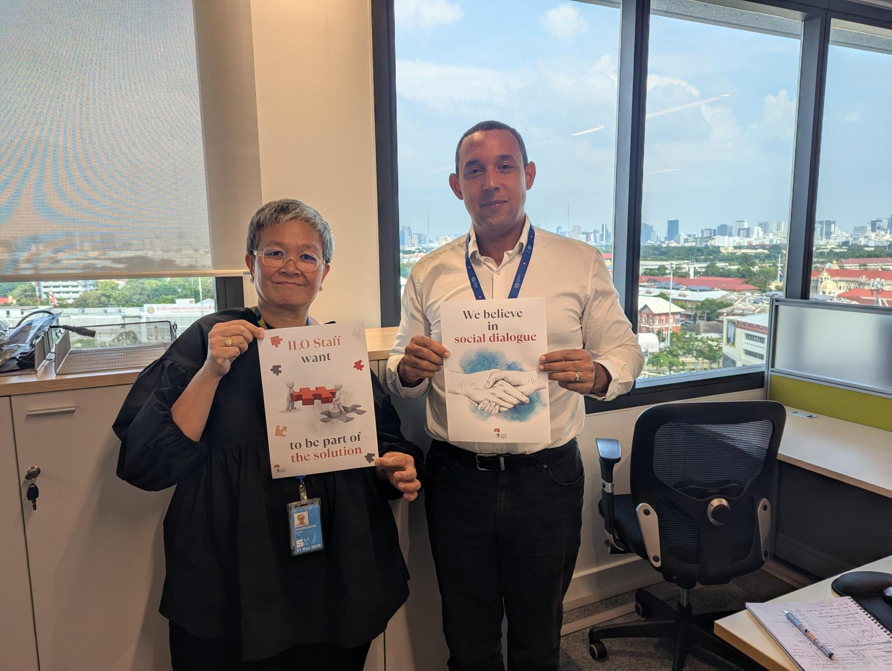


Slide 8
Strong decisions require strong dialogue

Slide 9



Slide 10
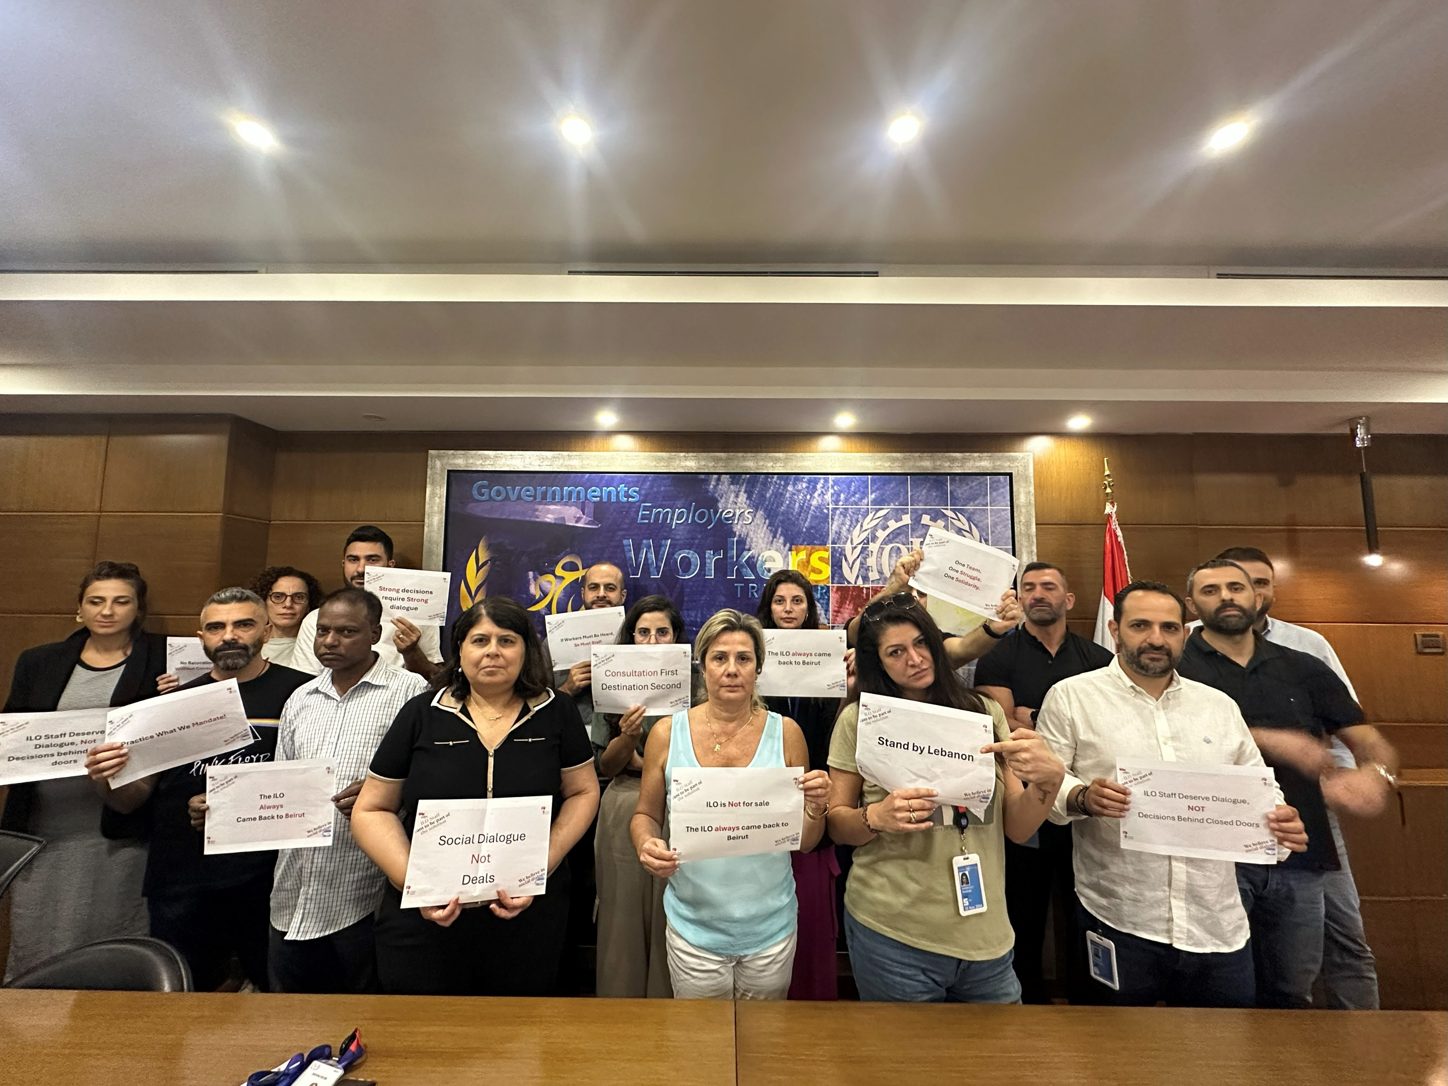
Consultations first, Destination second

Slide 11




Slide 12
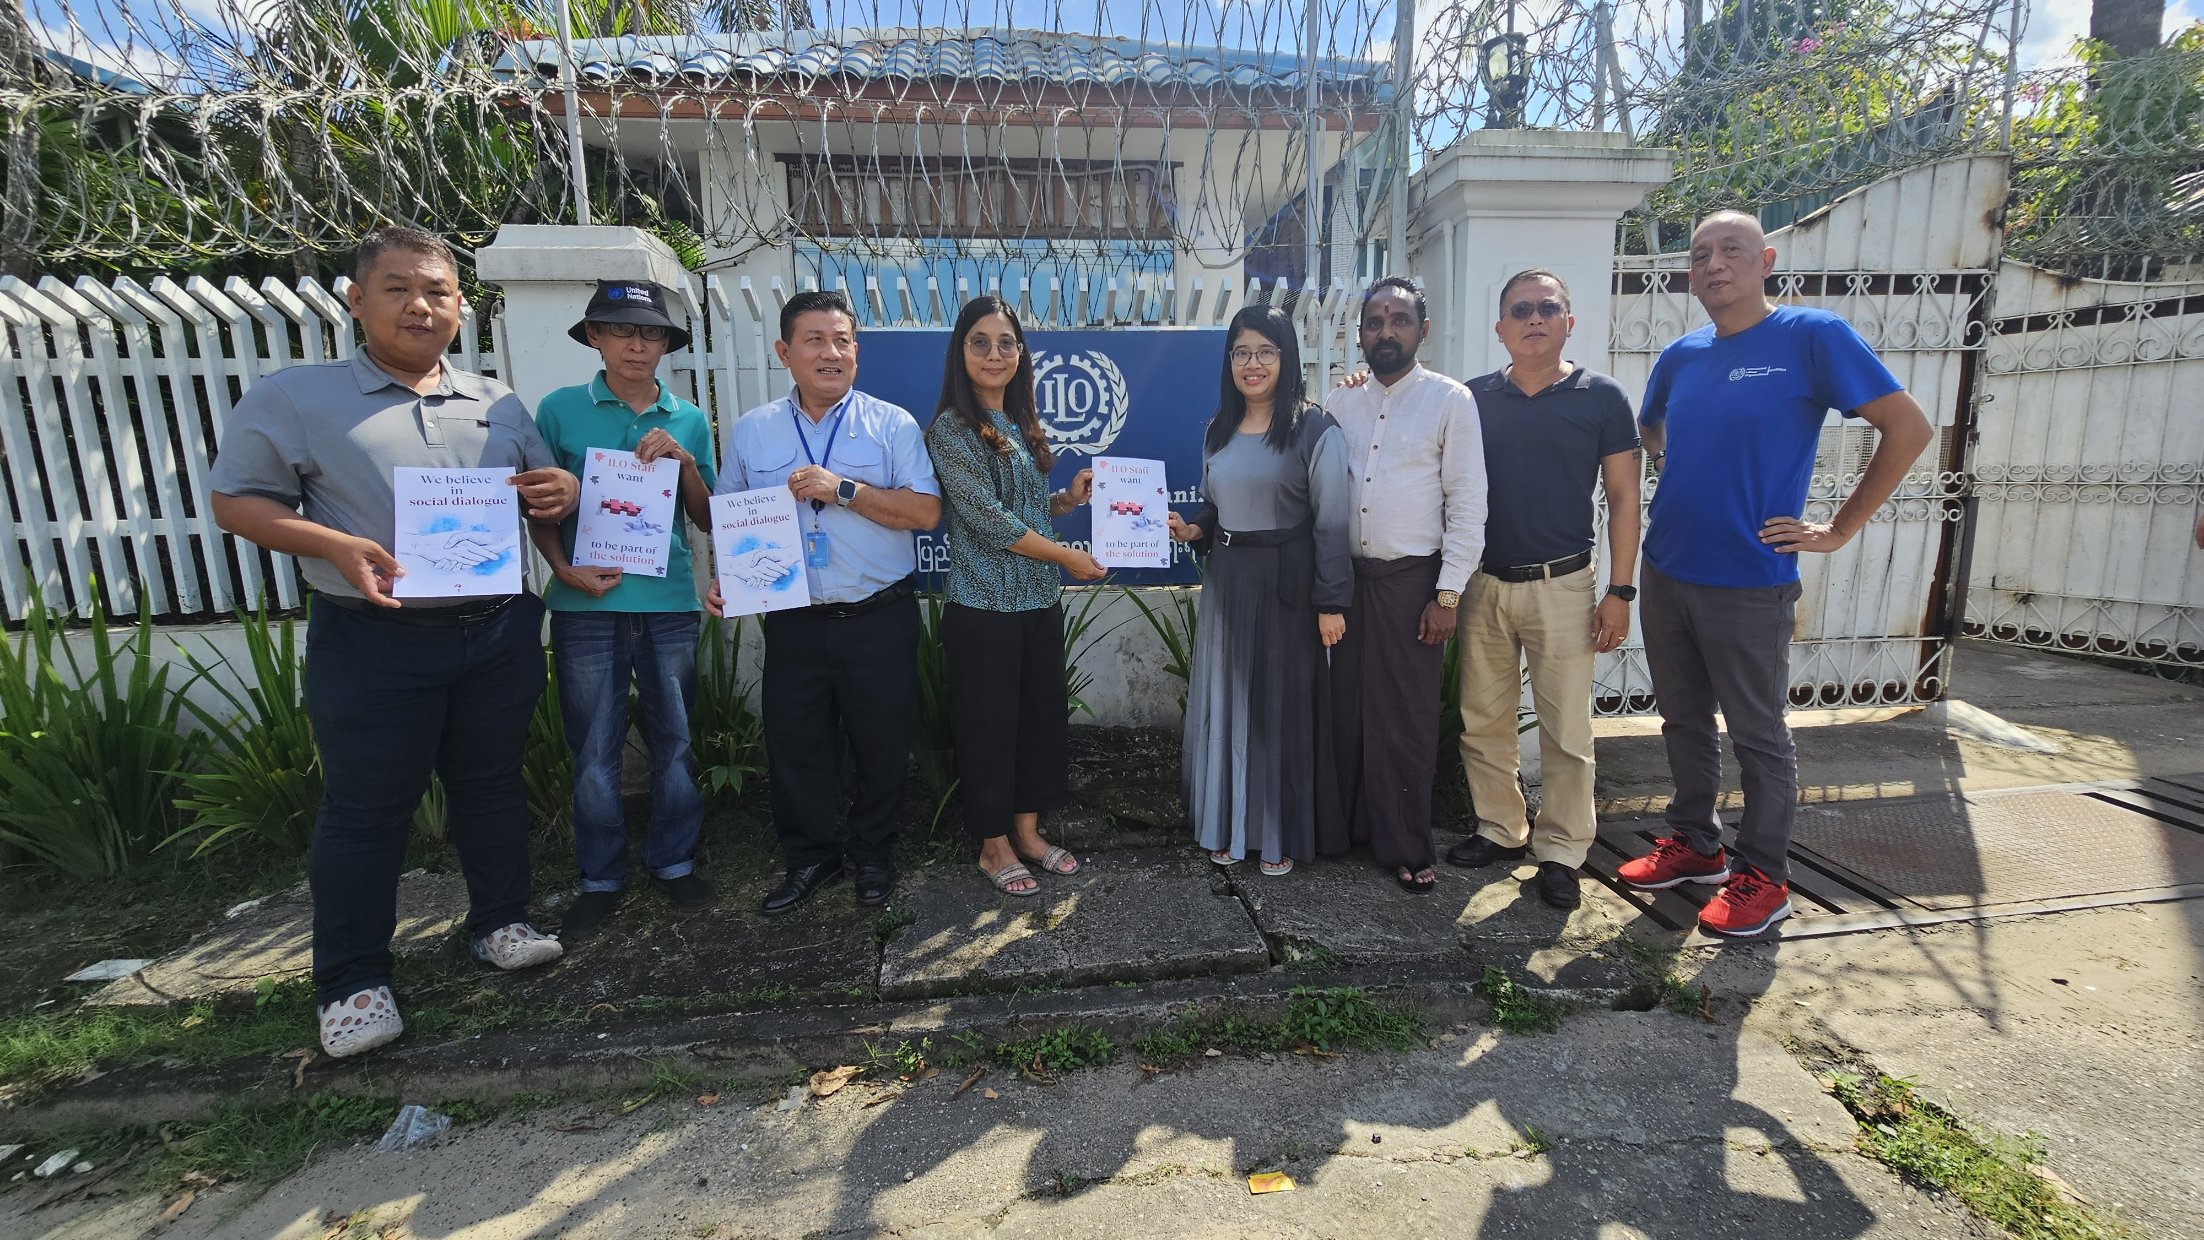

Care for your staff ! We care for the ILO…

Slide 13
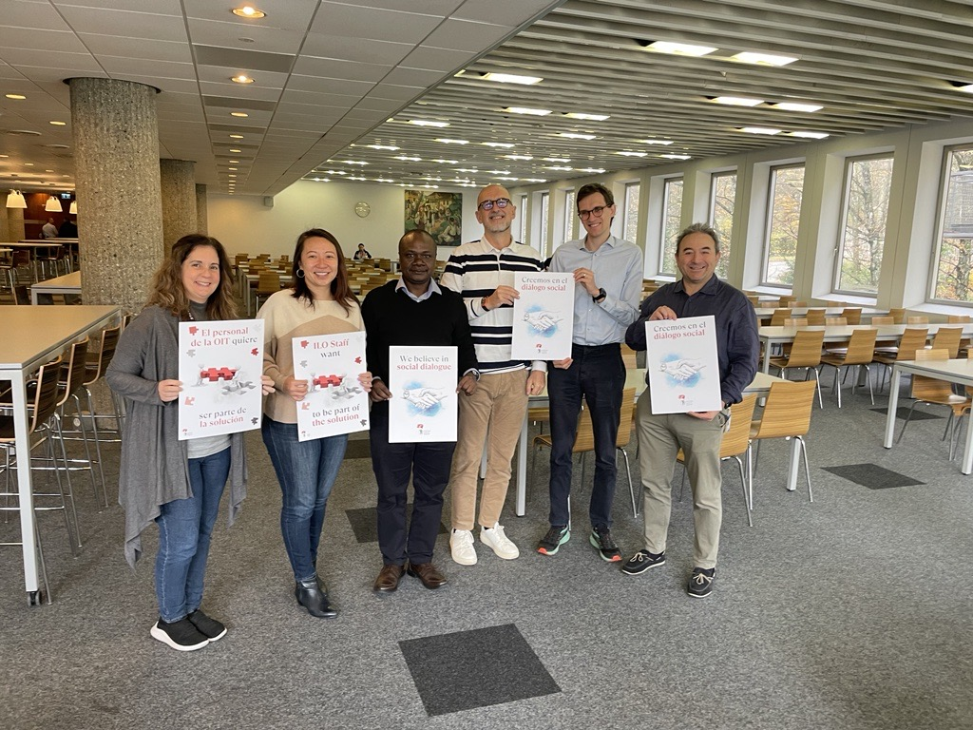
The ILO cannot preach dialogue while silencing its own…

Slide 14


Slide 15
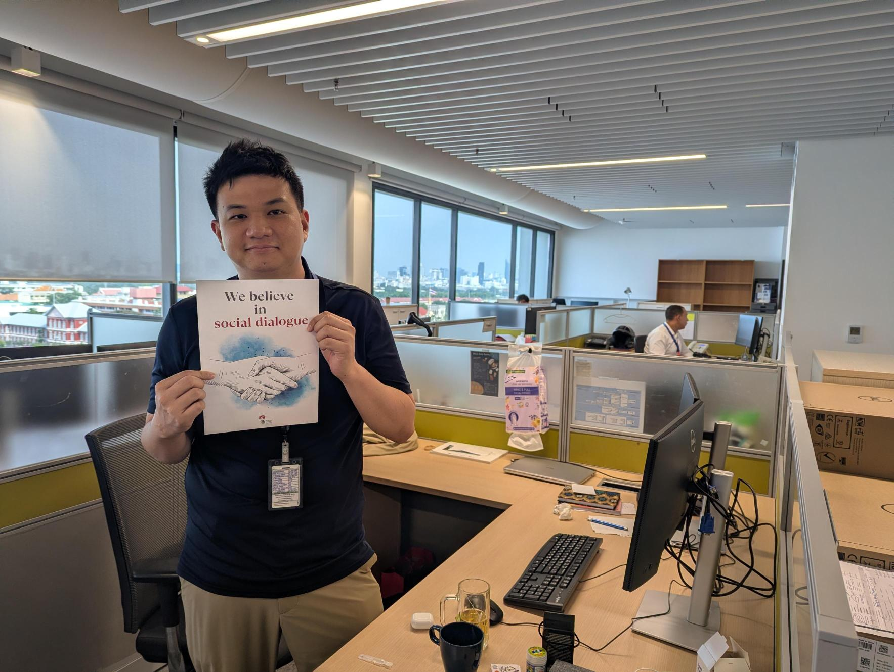
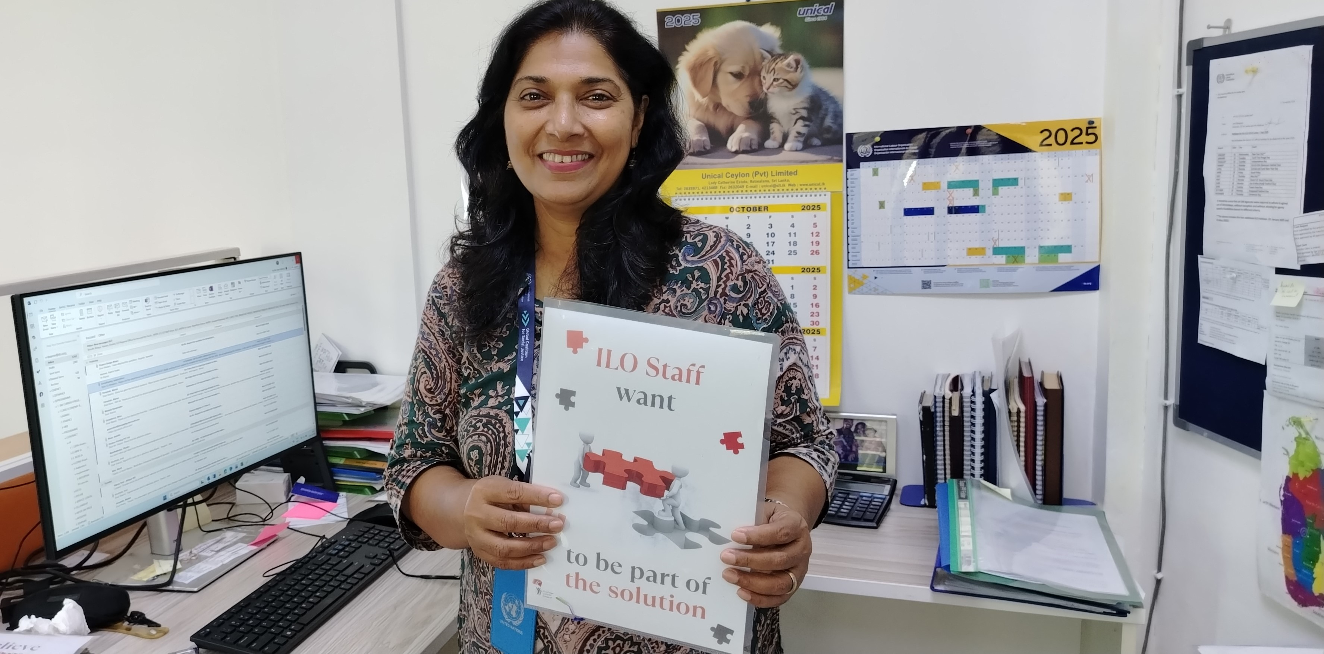
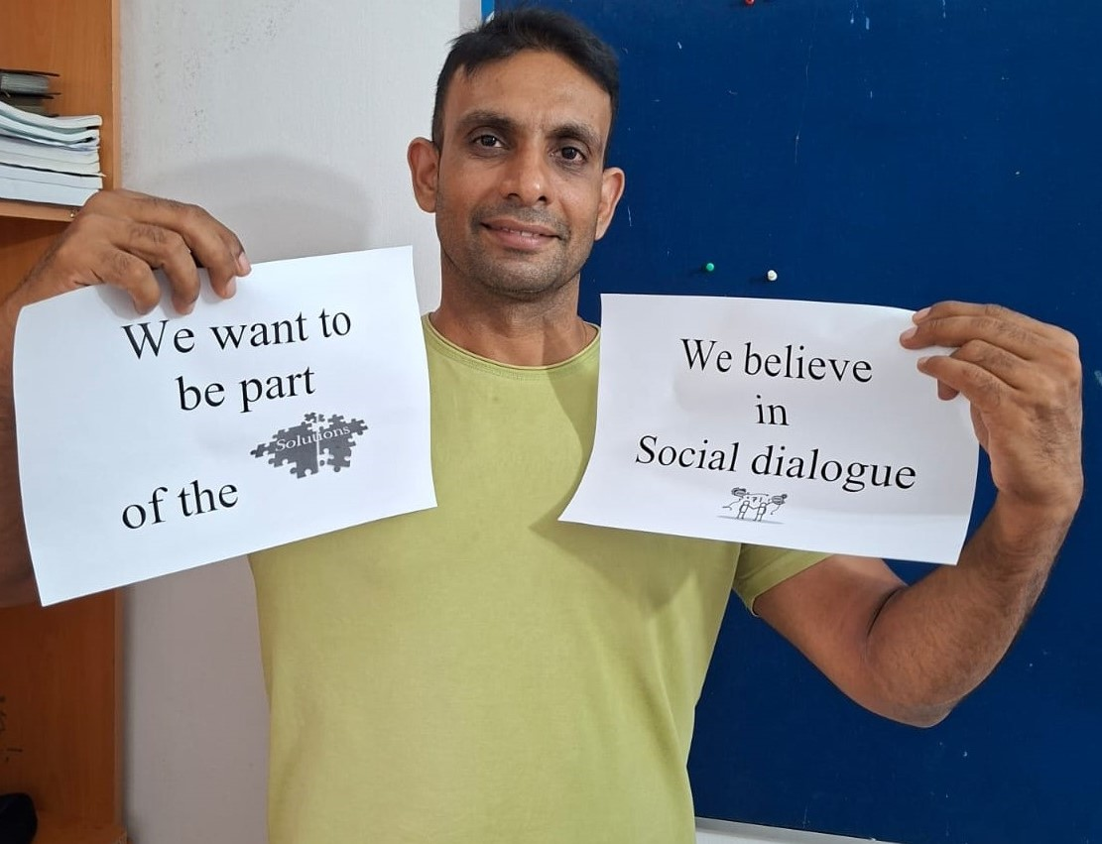

Slide 16
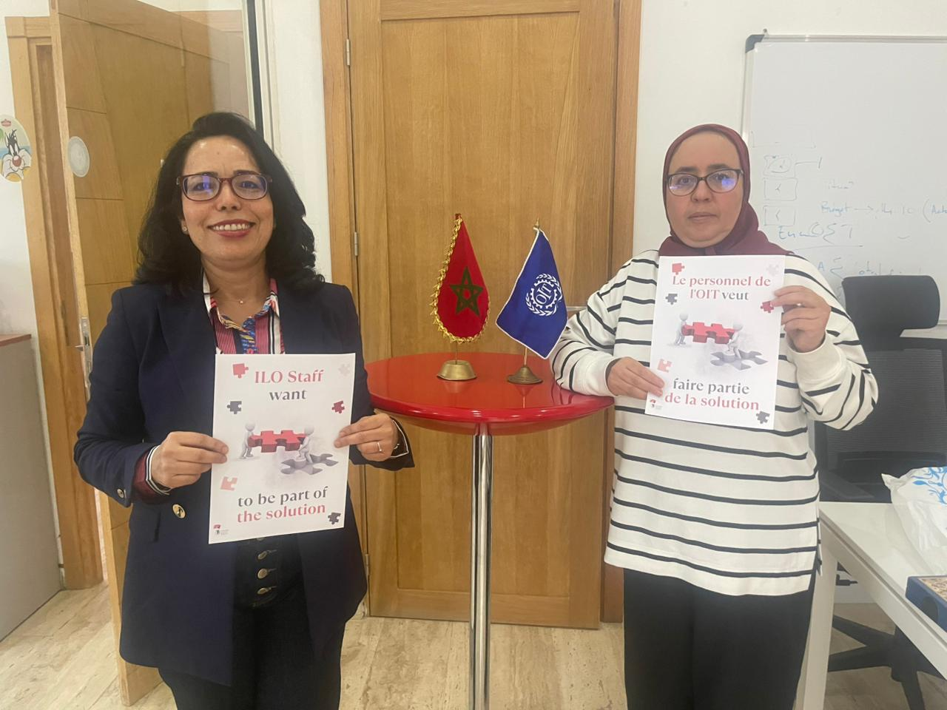

Slide 17
The ILO cannot preach dialogue while silencing its own…

Slide 18


Slide 19
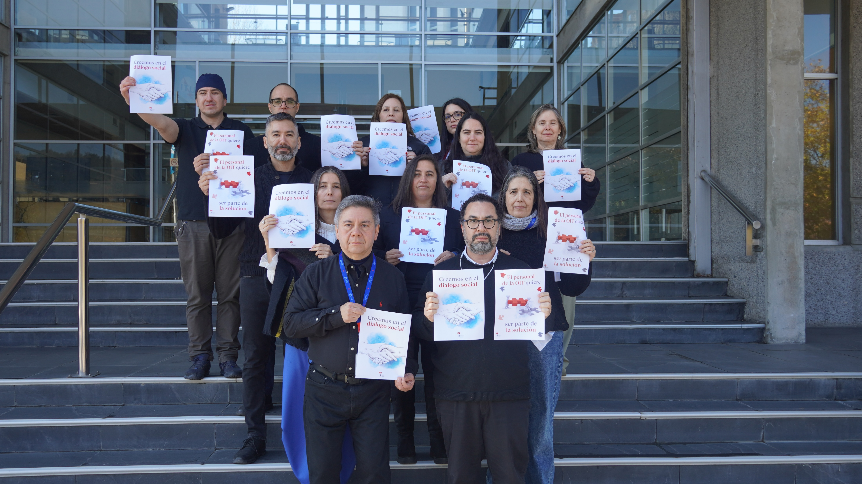
ILO staff deserve dialogue, not decisions behind closed doors…

Slide 20

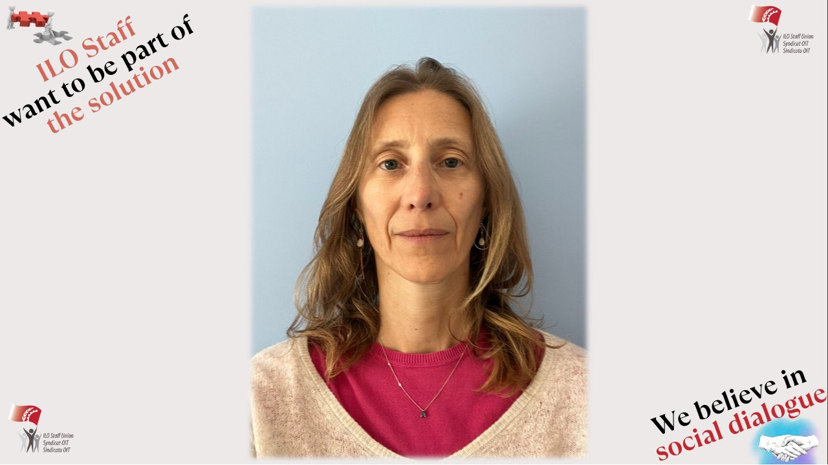
If workers must be heard, so must staff

Slide 21
ILO is not for Sale

Slide 22


Slide 23
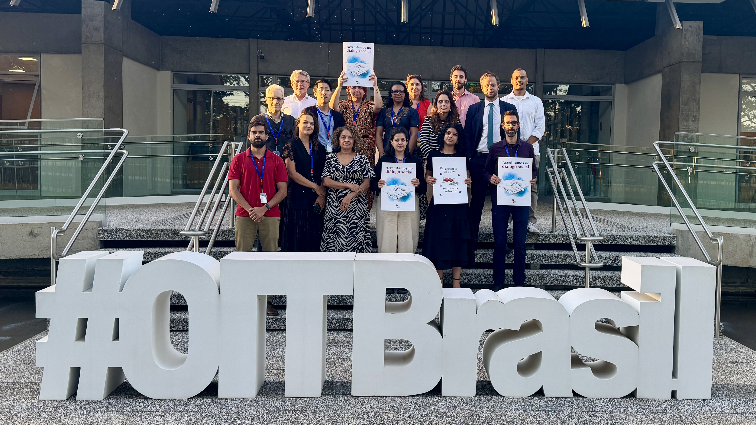
Care for your staff ! We care for the ILO…

Slide 25


Slide 26
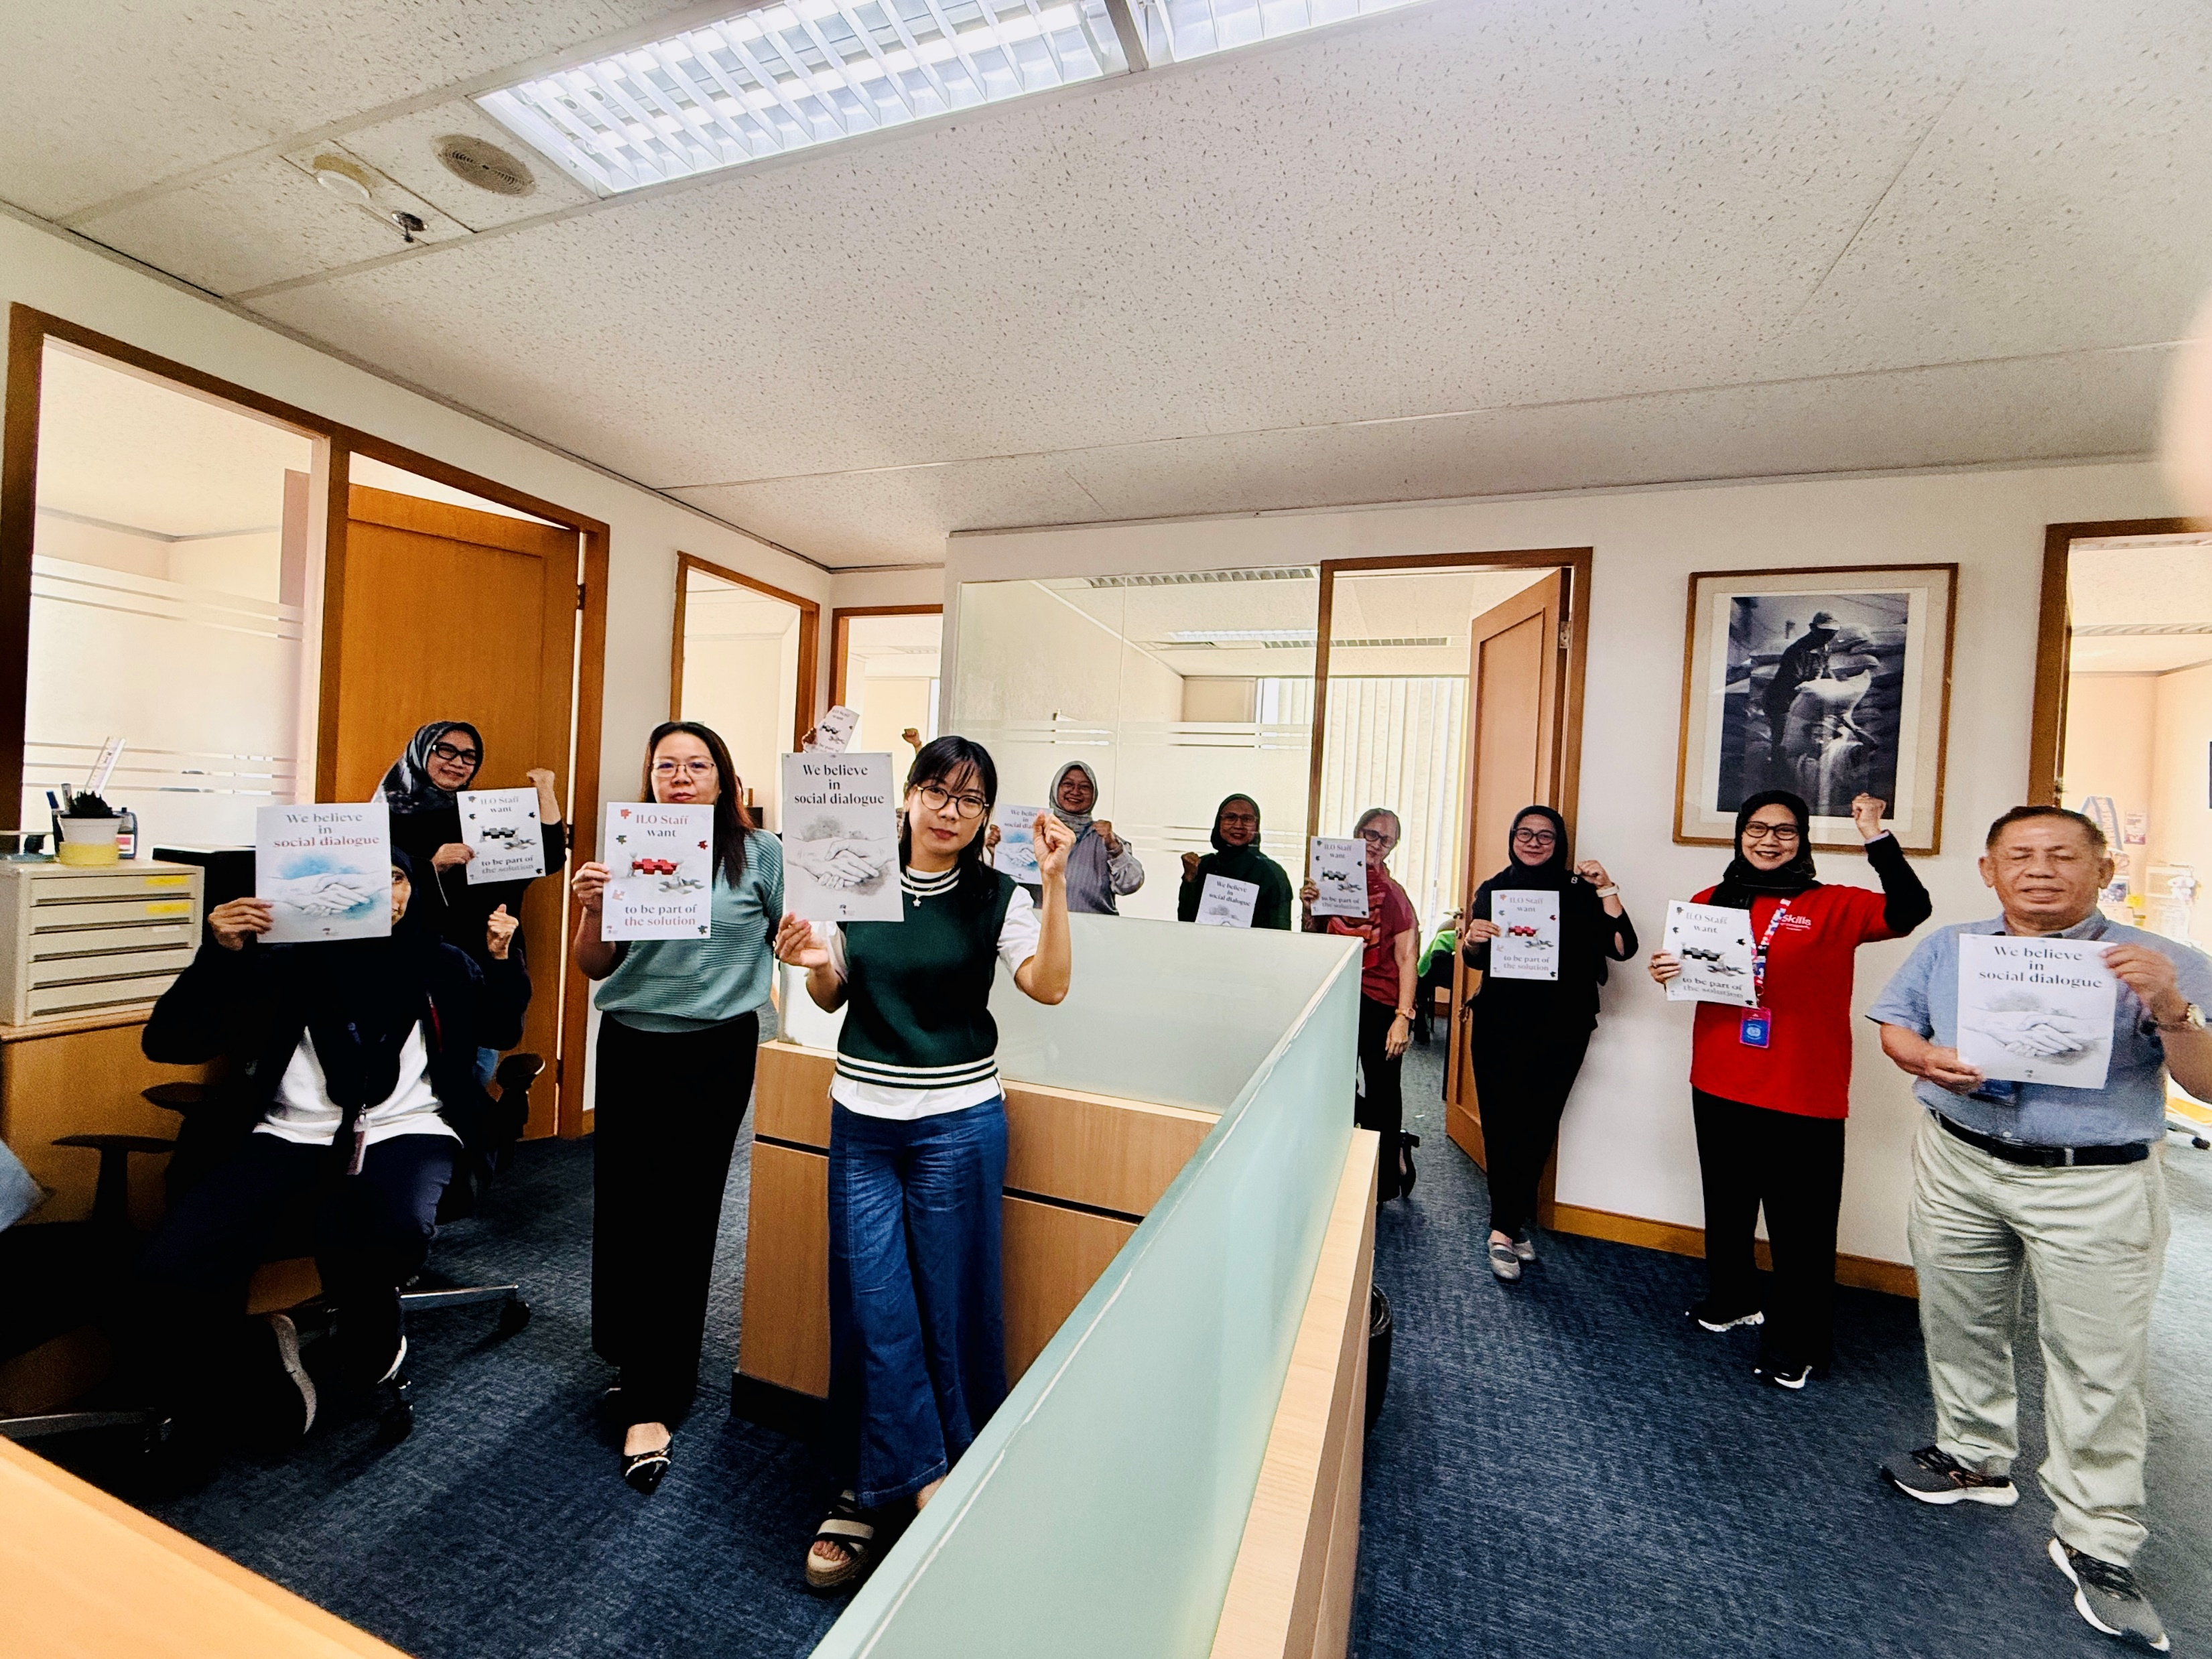
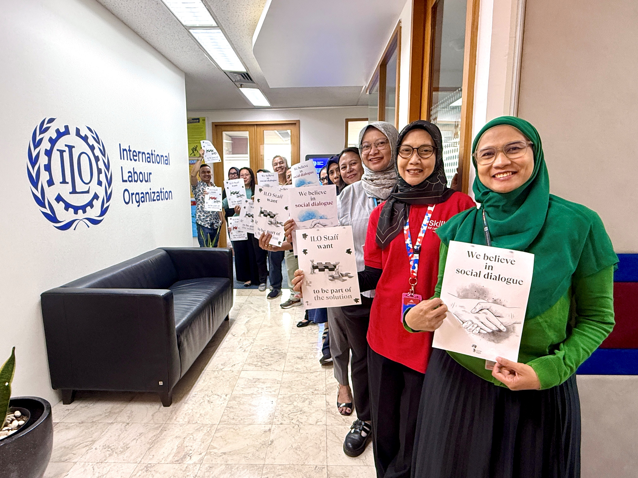
ILO staff deserve dialogue, not decisions behind closed doors…

Slide 27

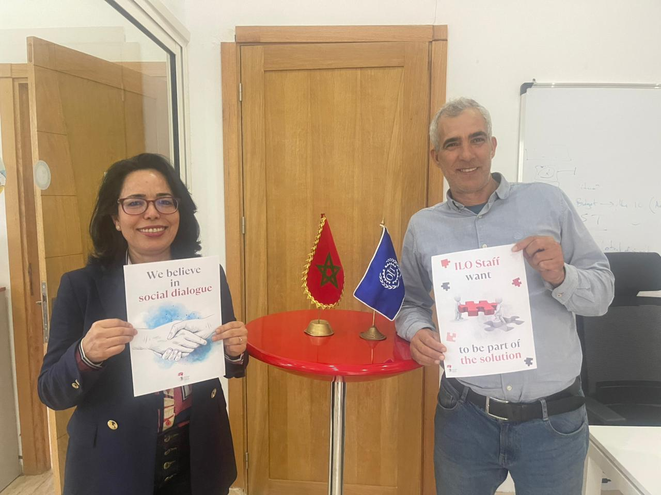

Slide 28

We want to be heard !

Slide 29
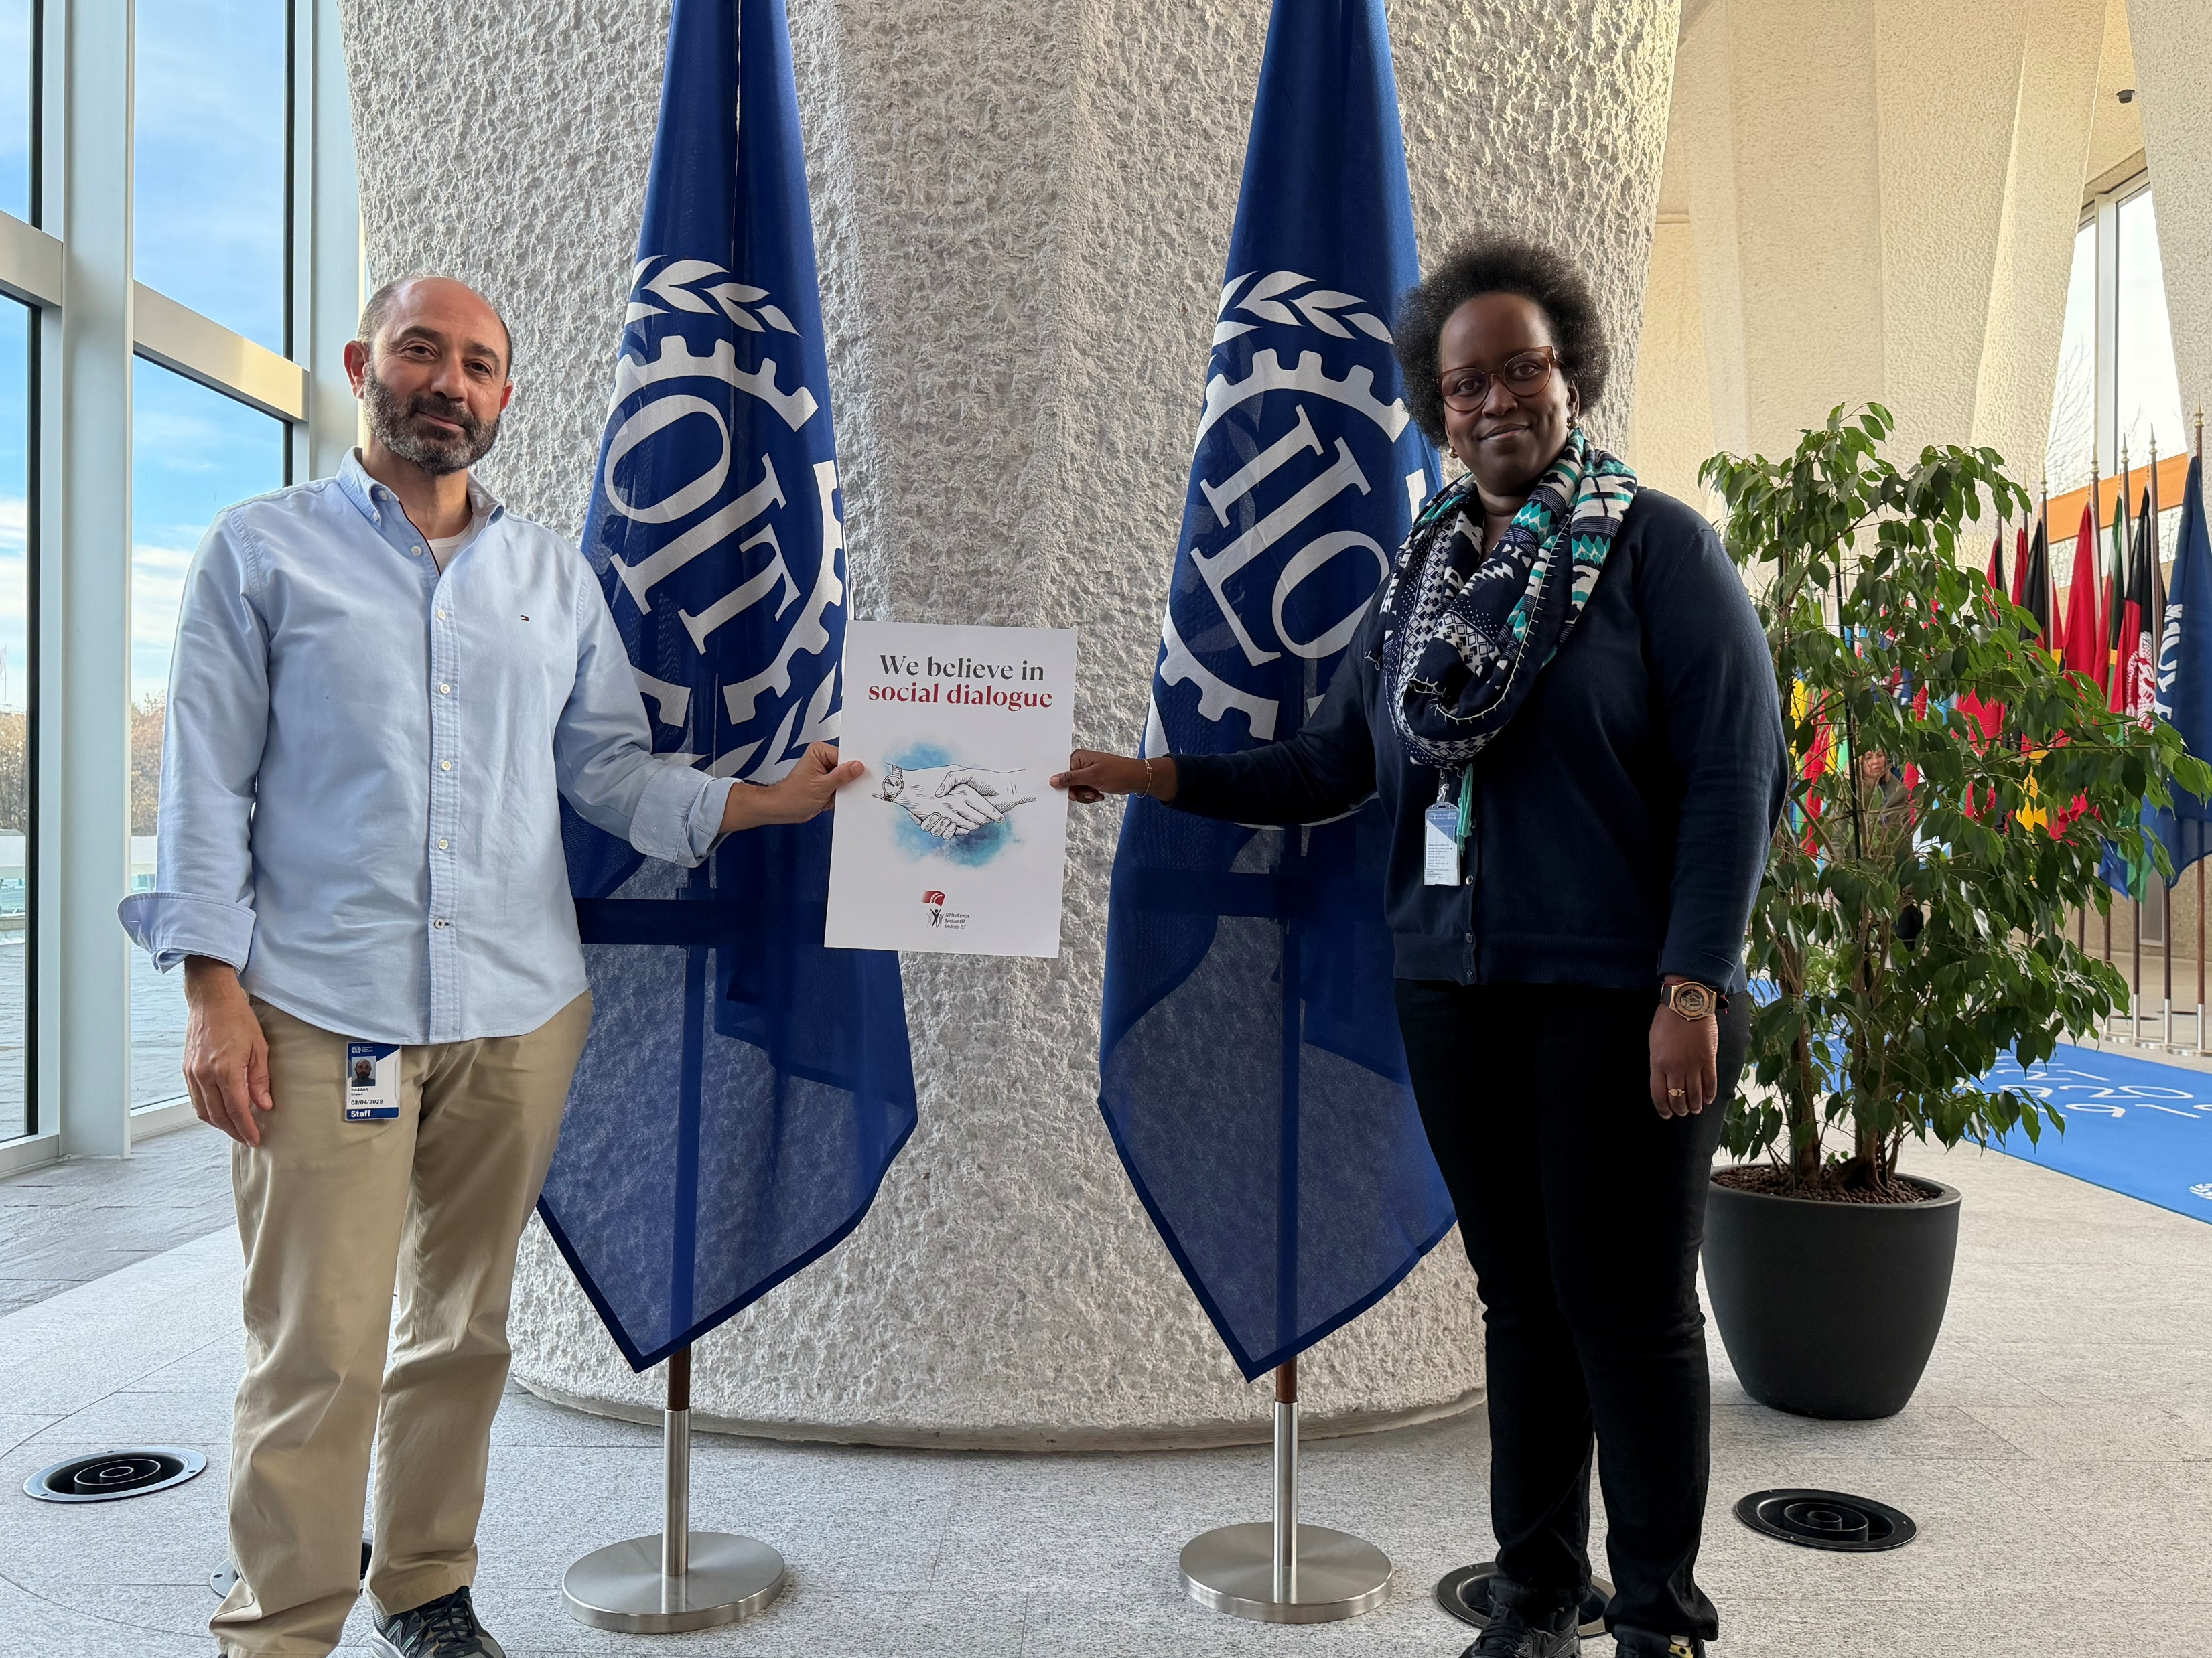

Slide 31
We teach dialogue world wide, why skip it here?

Slide 32
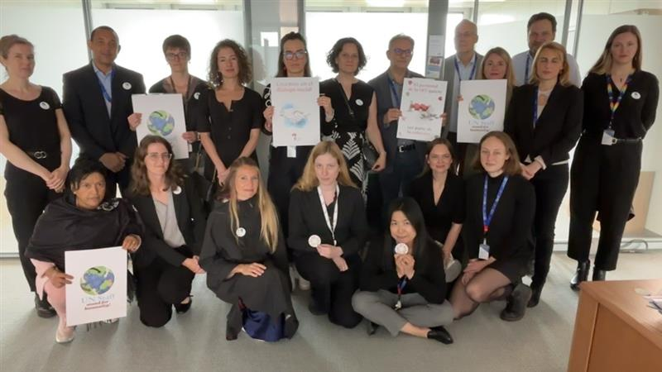
Staff are stakeholders too!

Slide 33
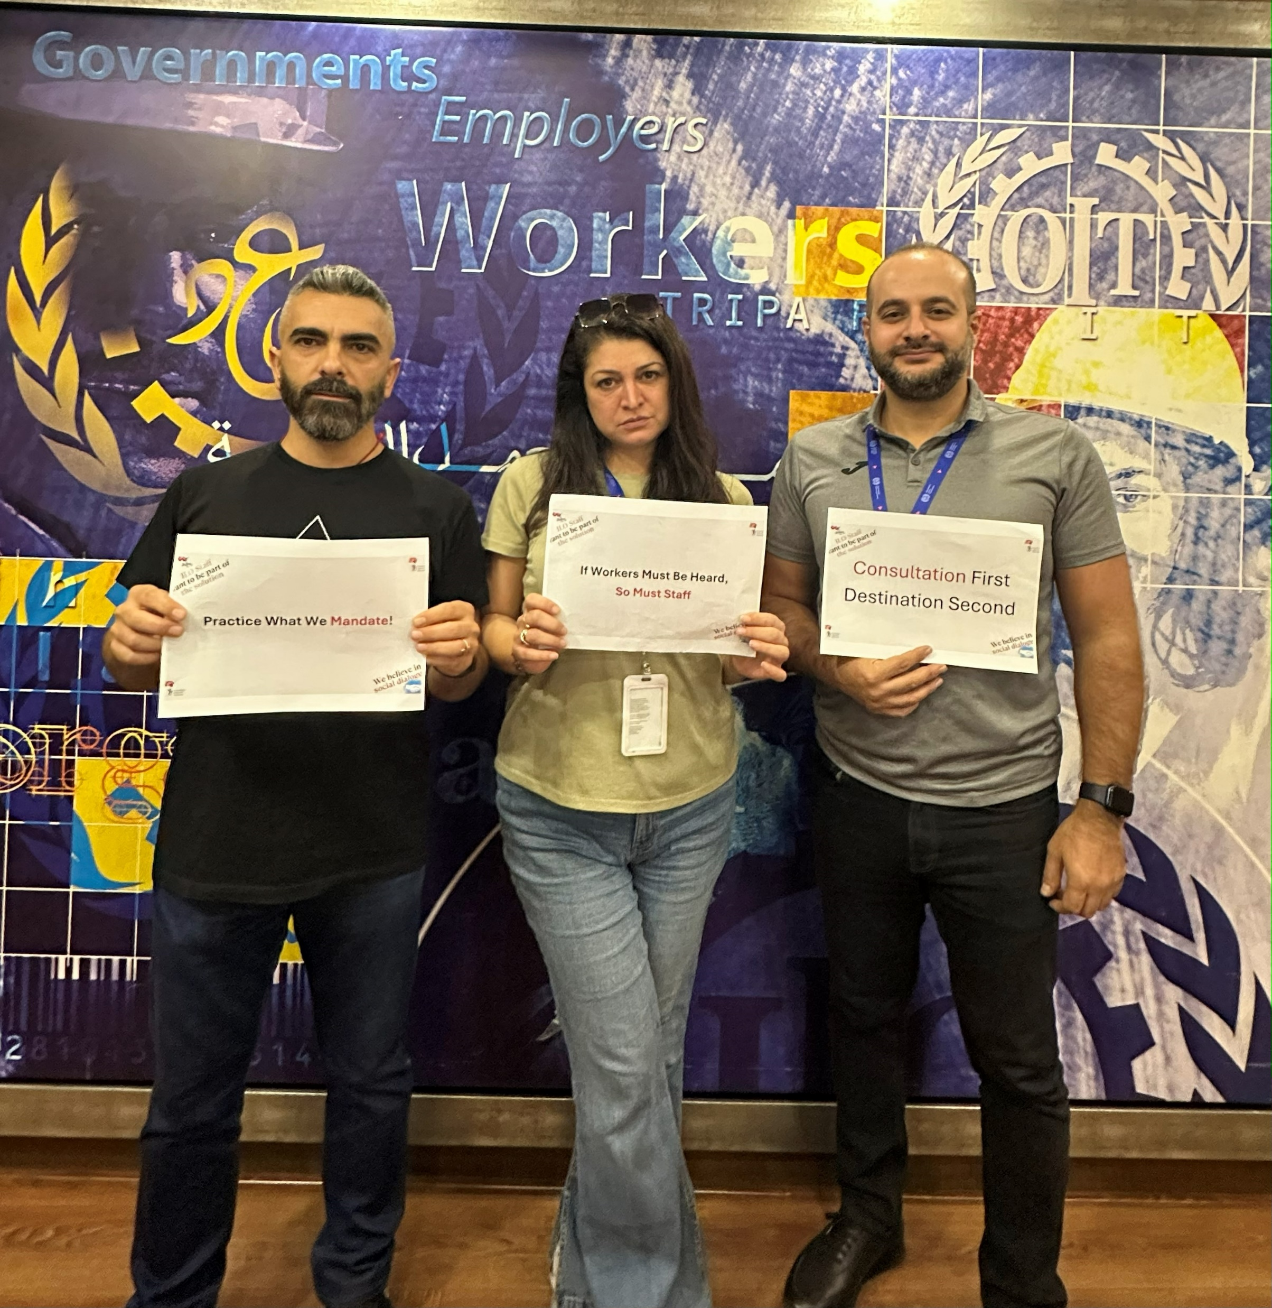
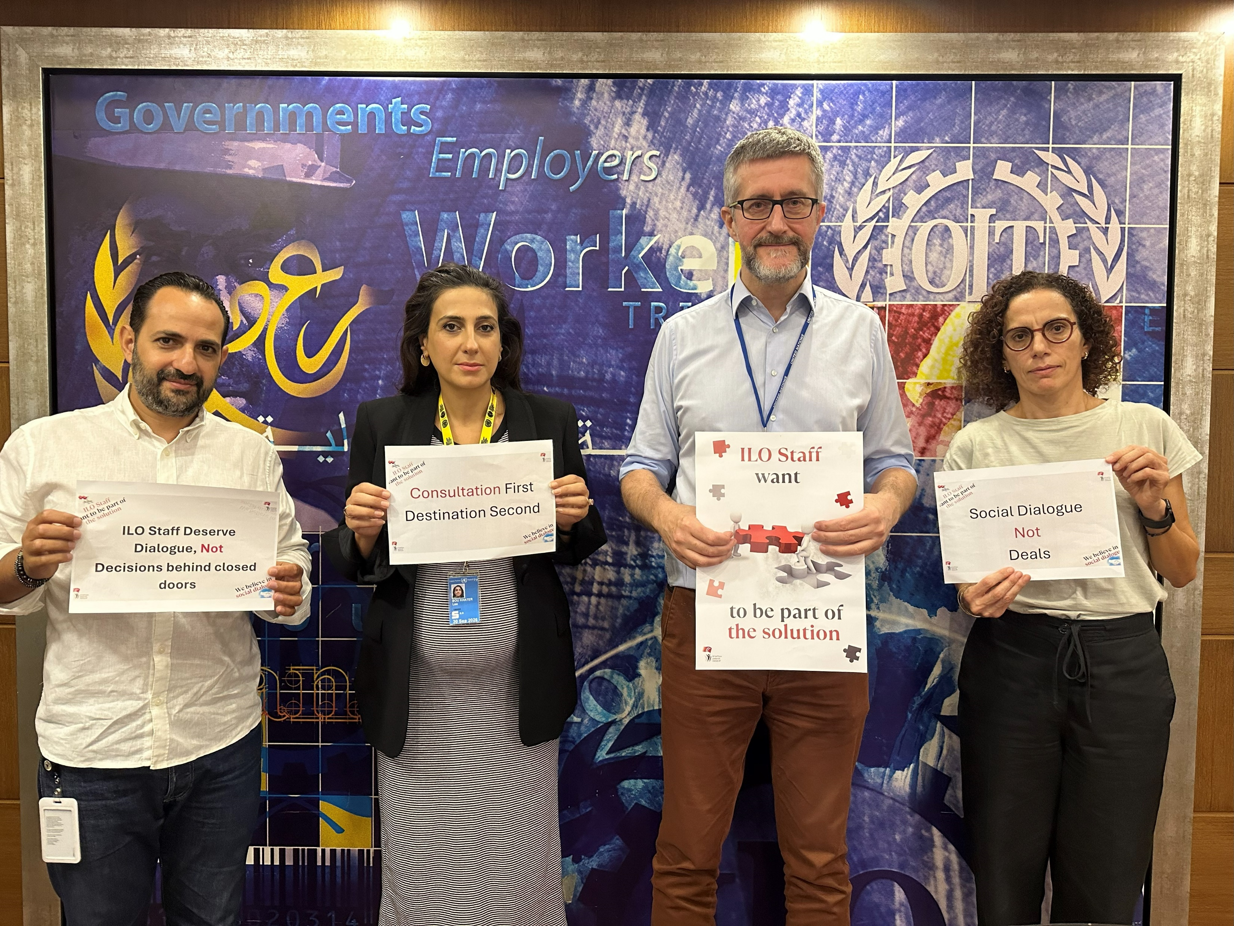
No relocation from Beirut without consultation with Beirut

Slide 34
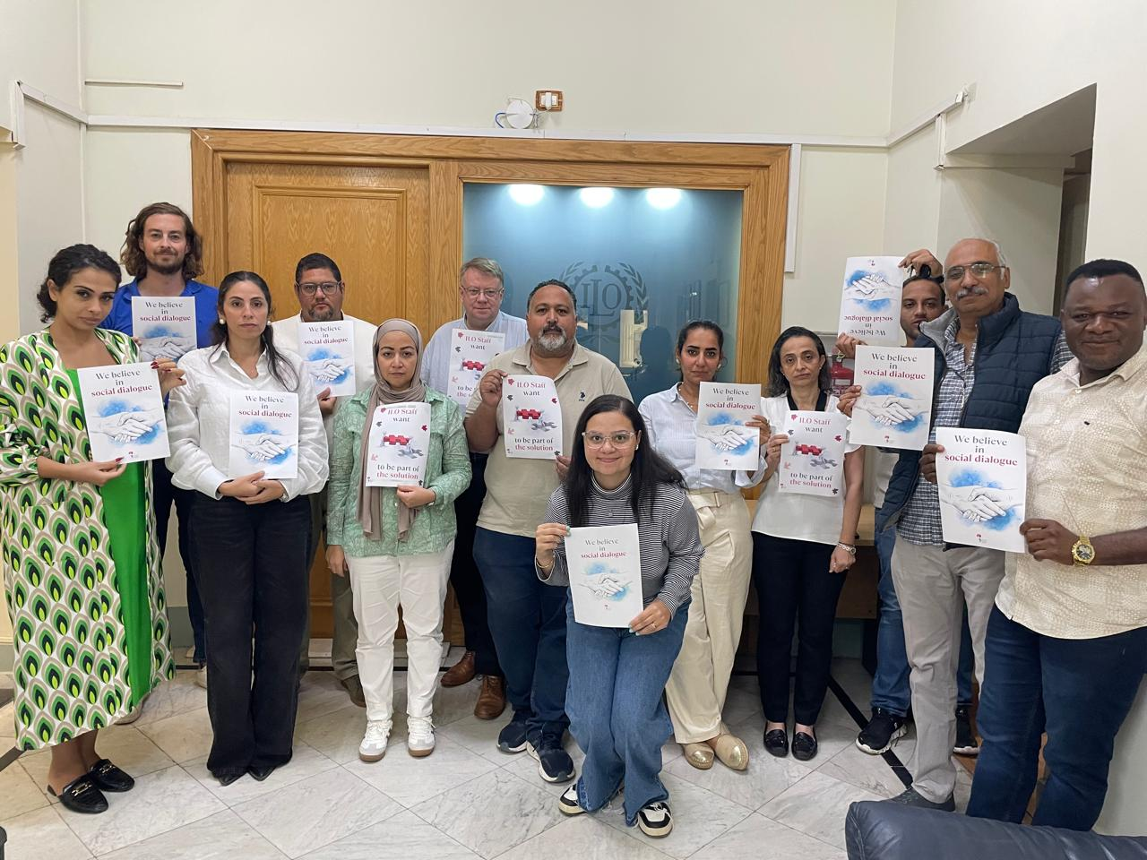

Slide 35
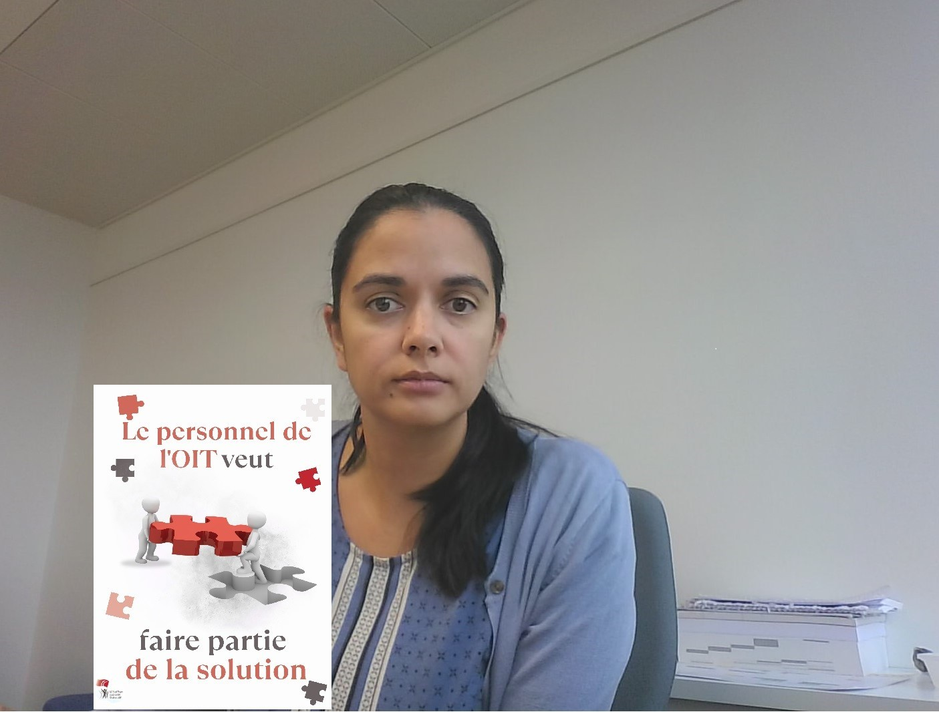
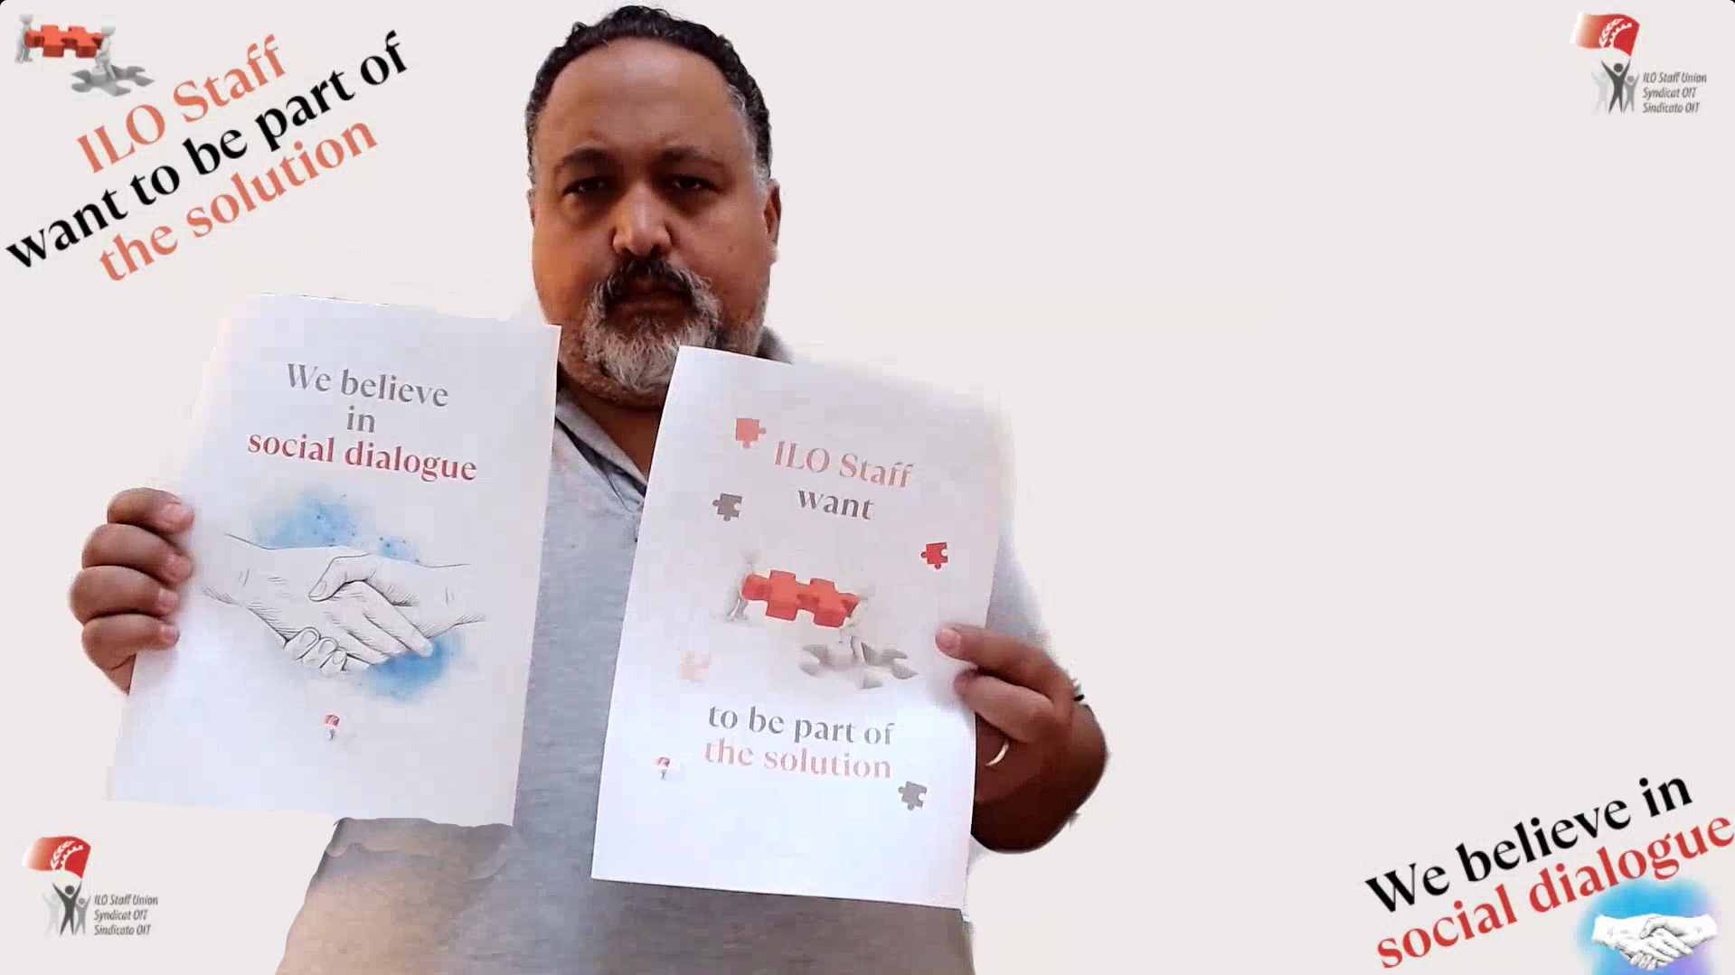
If workers must be heard, so must staff

Slide 36
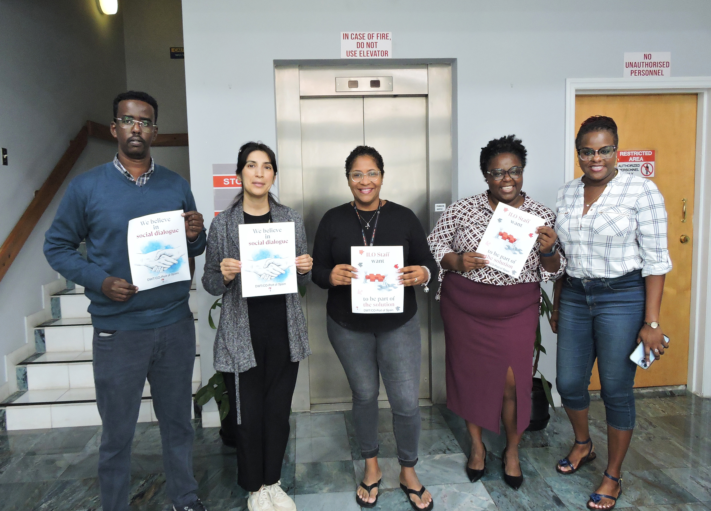
We teach dialogue world wide, why skip it here?

Slide 37





Slide 38
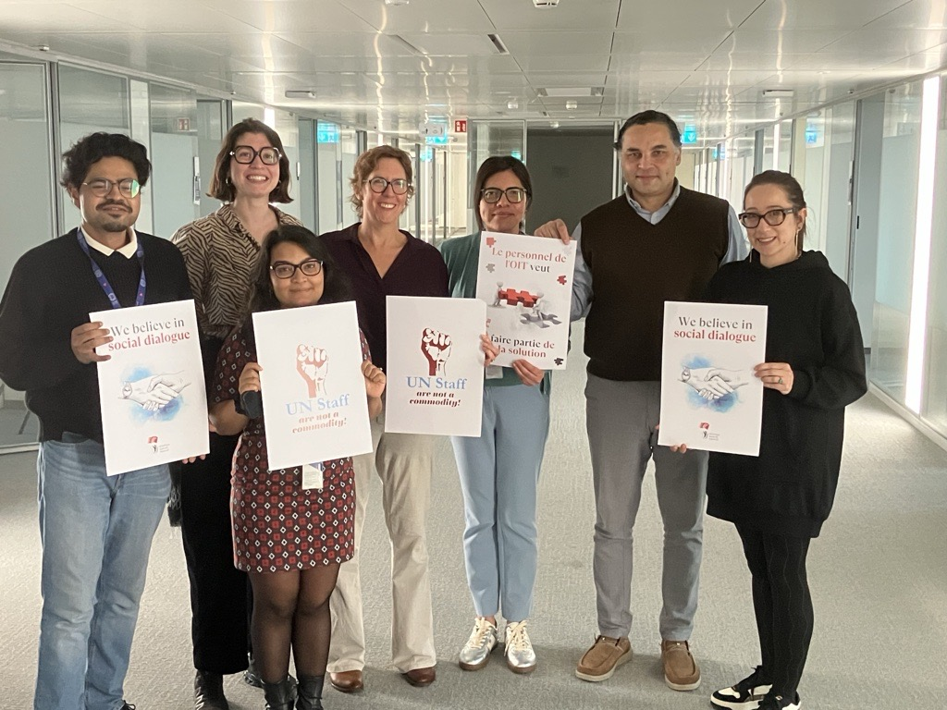
Staff are stakeholders too!

Slide 39
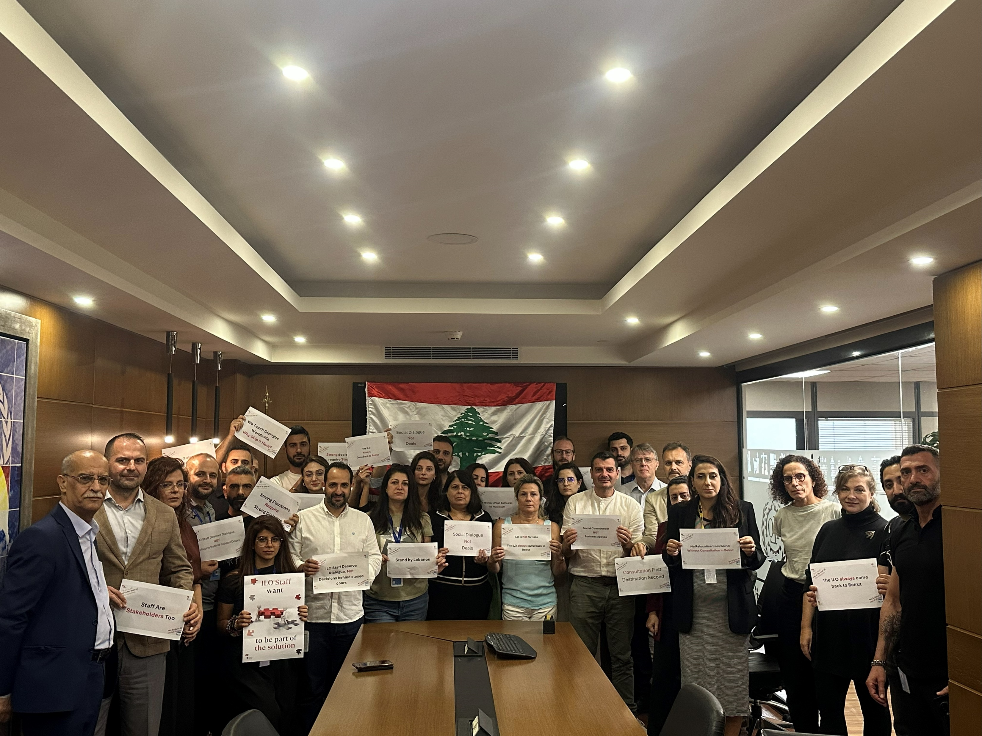
ILO always comes back to Beirut

Slide 40


Strong decisions require strong dialogue

Slide 42

ILO Staff believe in social dialogue

Slide 43

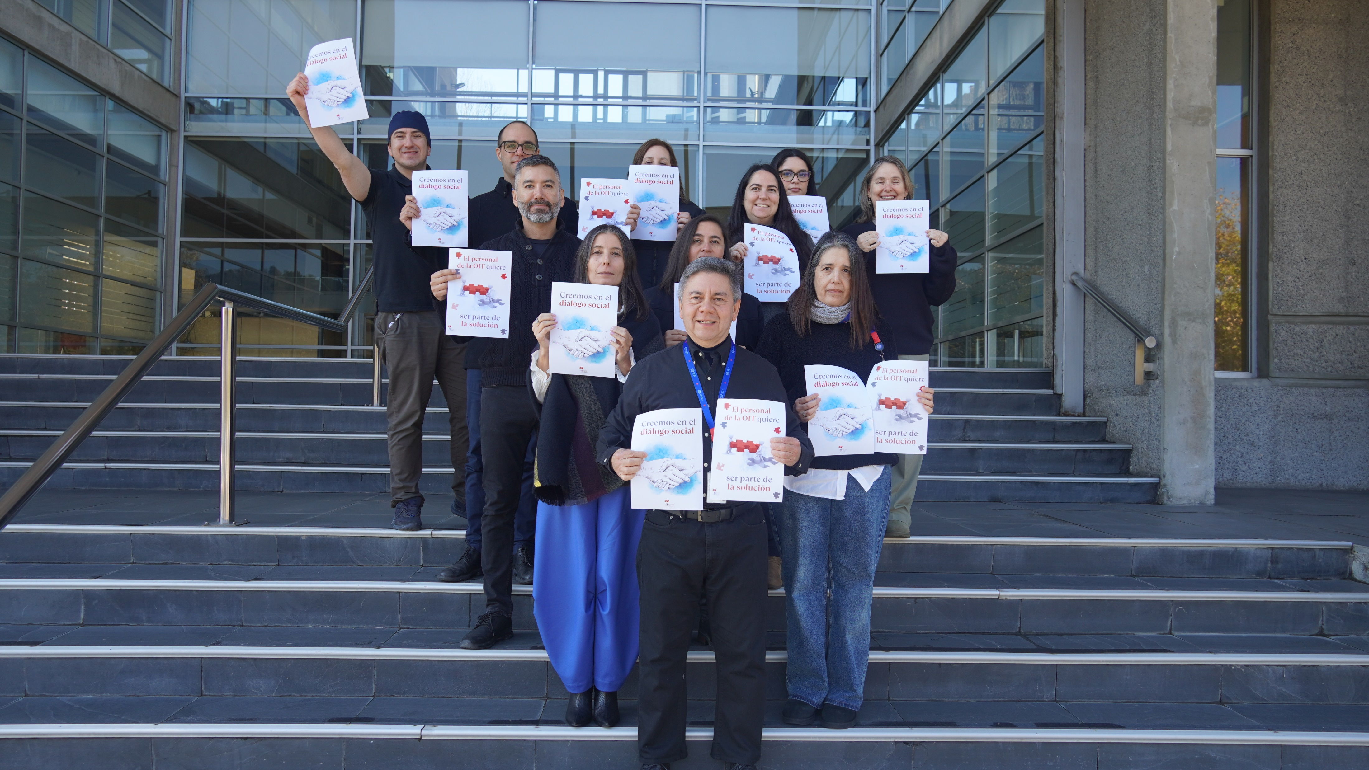

Slide 44
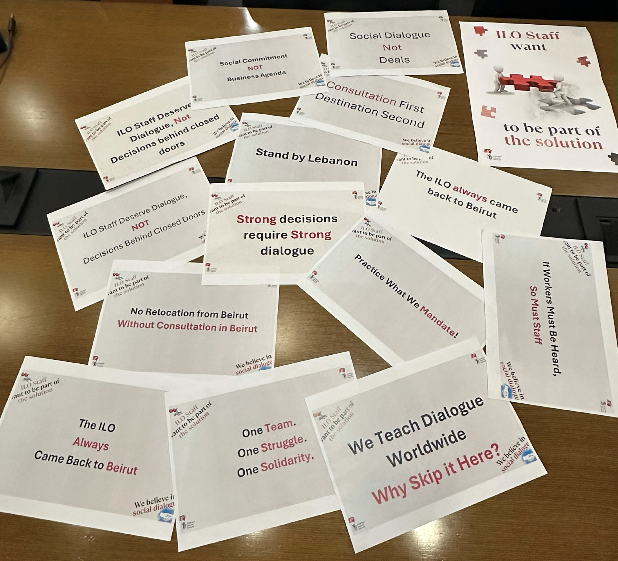

Slide 45
Social Dialogue, not Deals

Slide 46





Slide 47

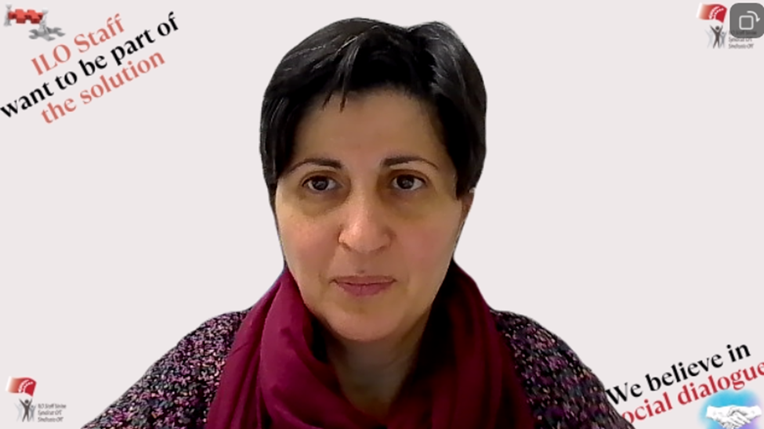

Slide 48
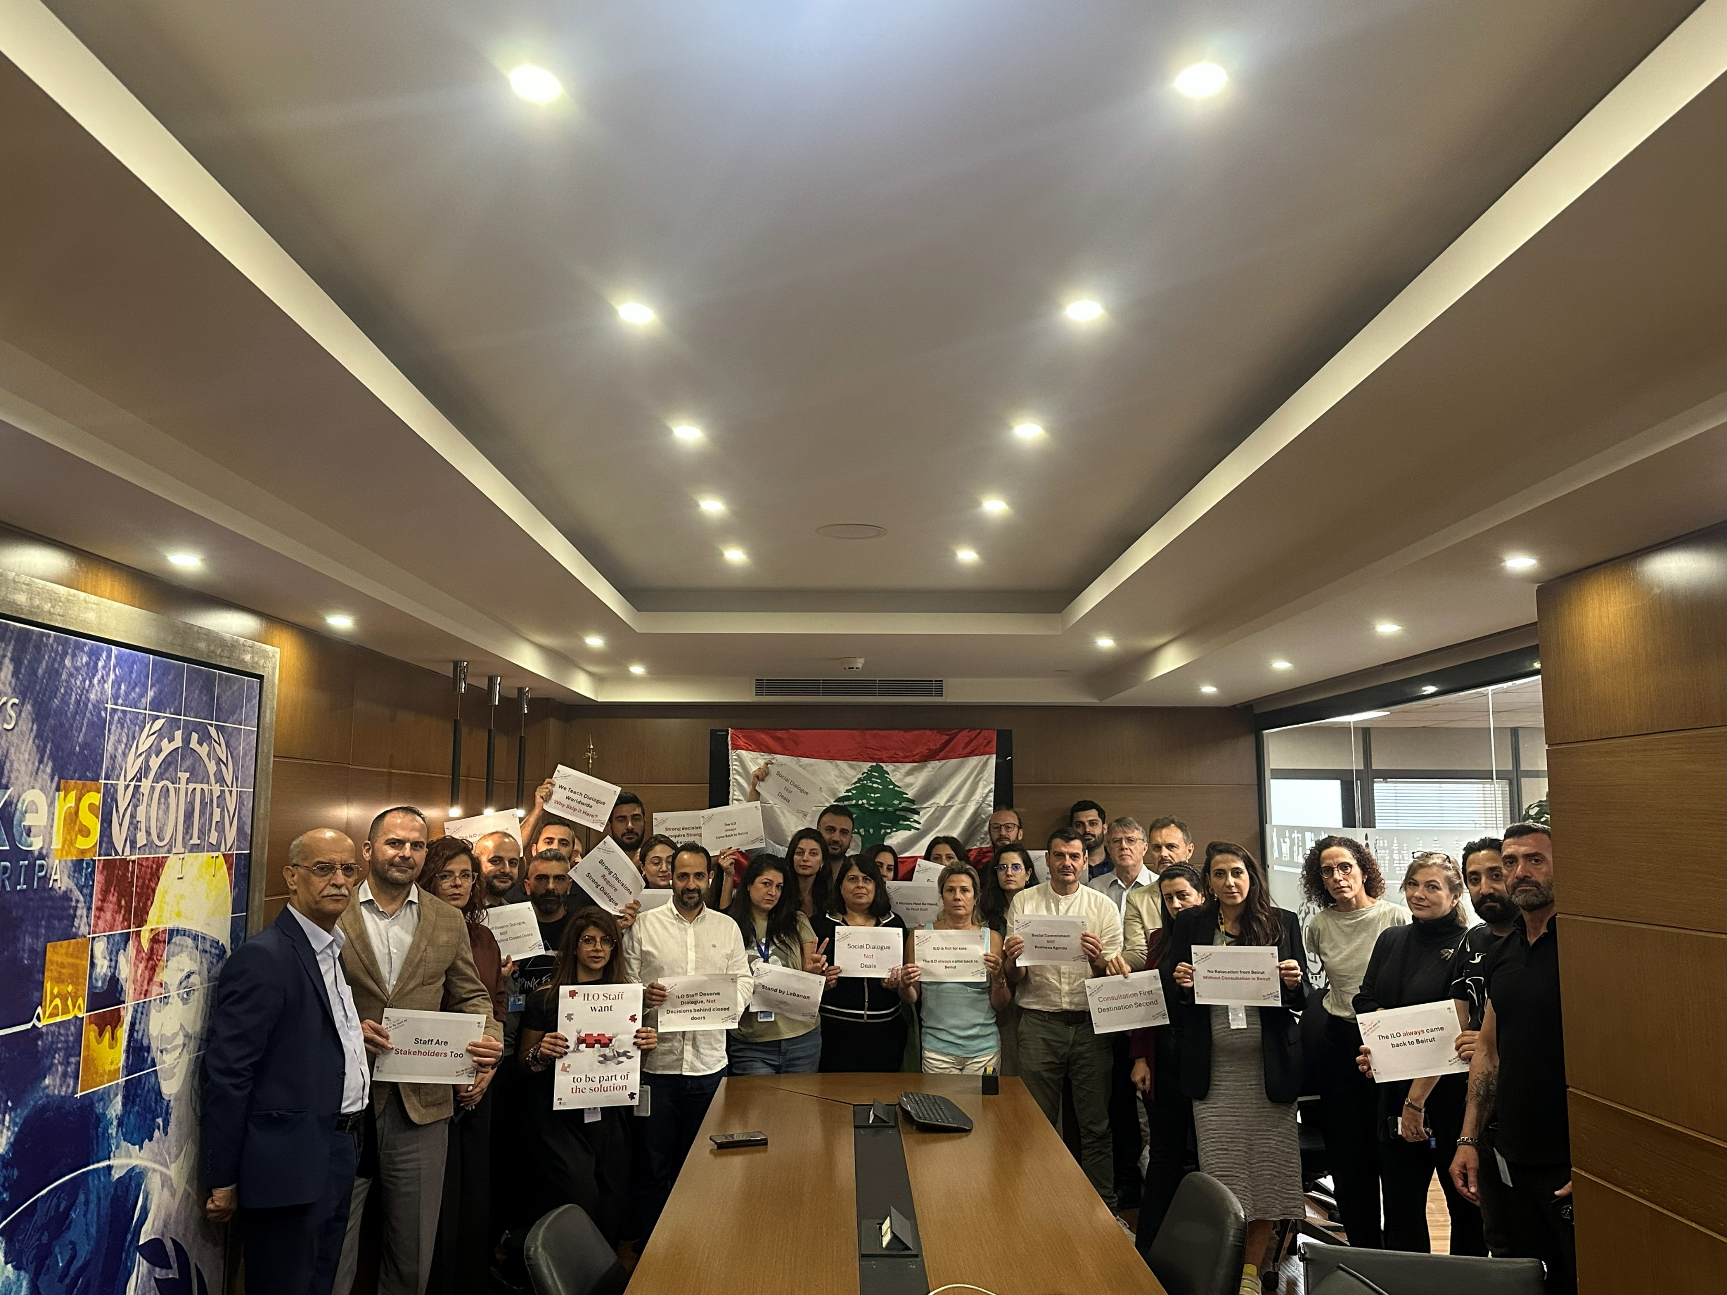
The Levant is rebuilding... Don't remove the institution that supports workers

Slide 49

Nous voulons être entendus !

Slide 50


